Slide 1
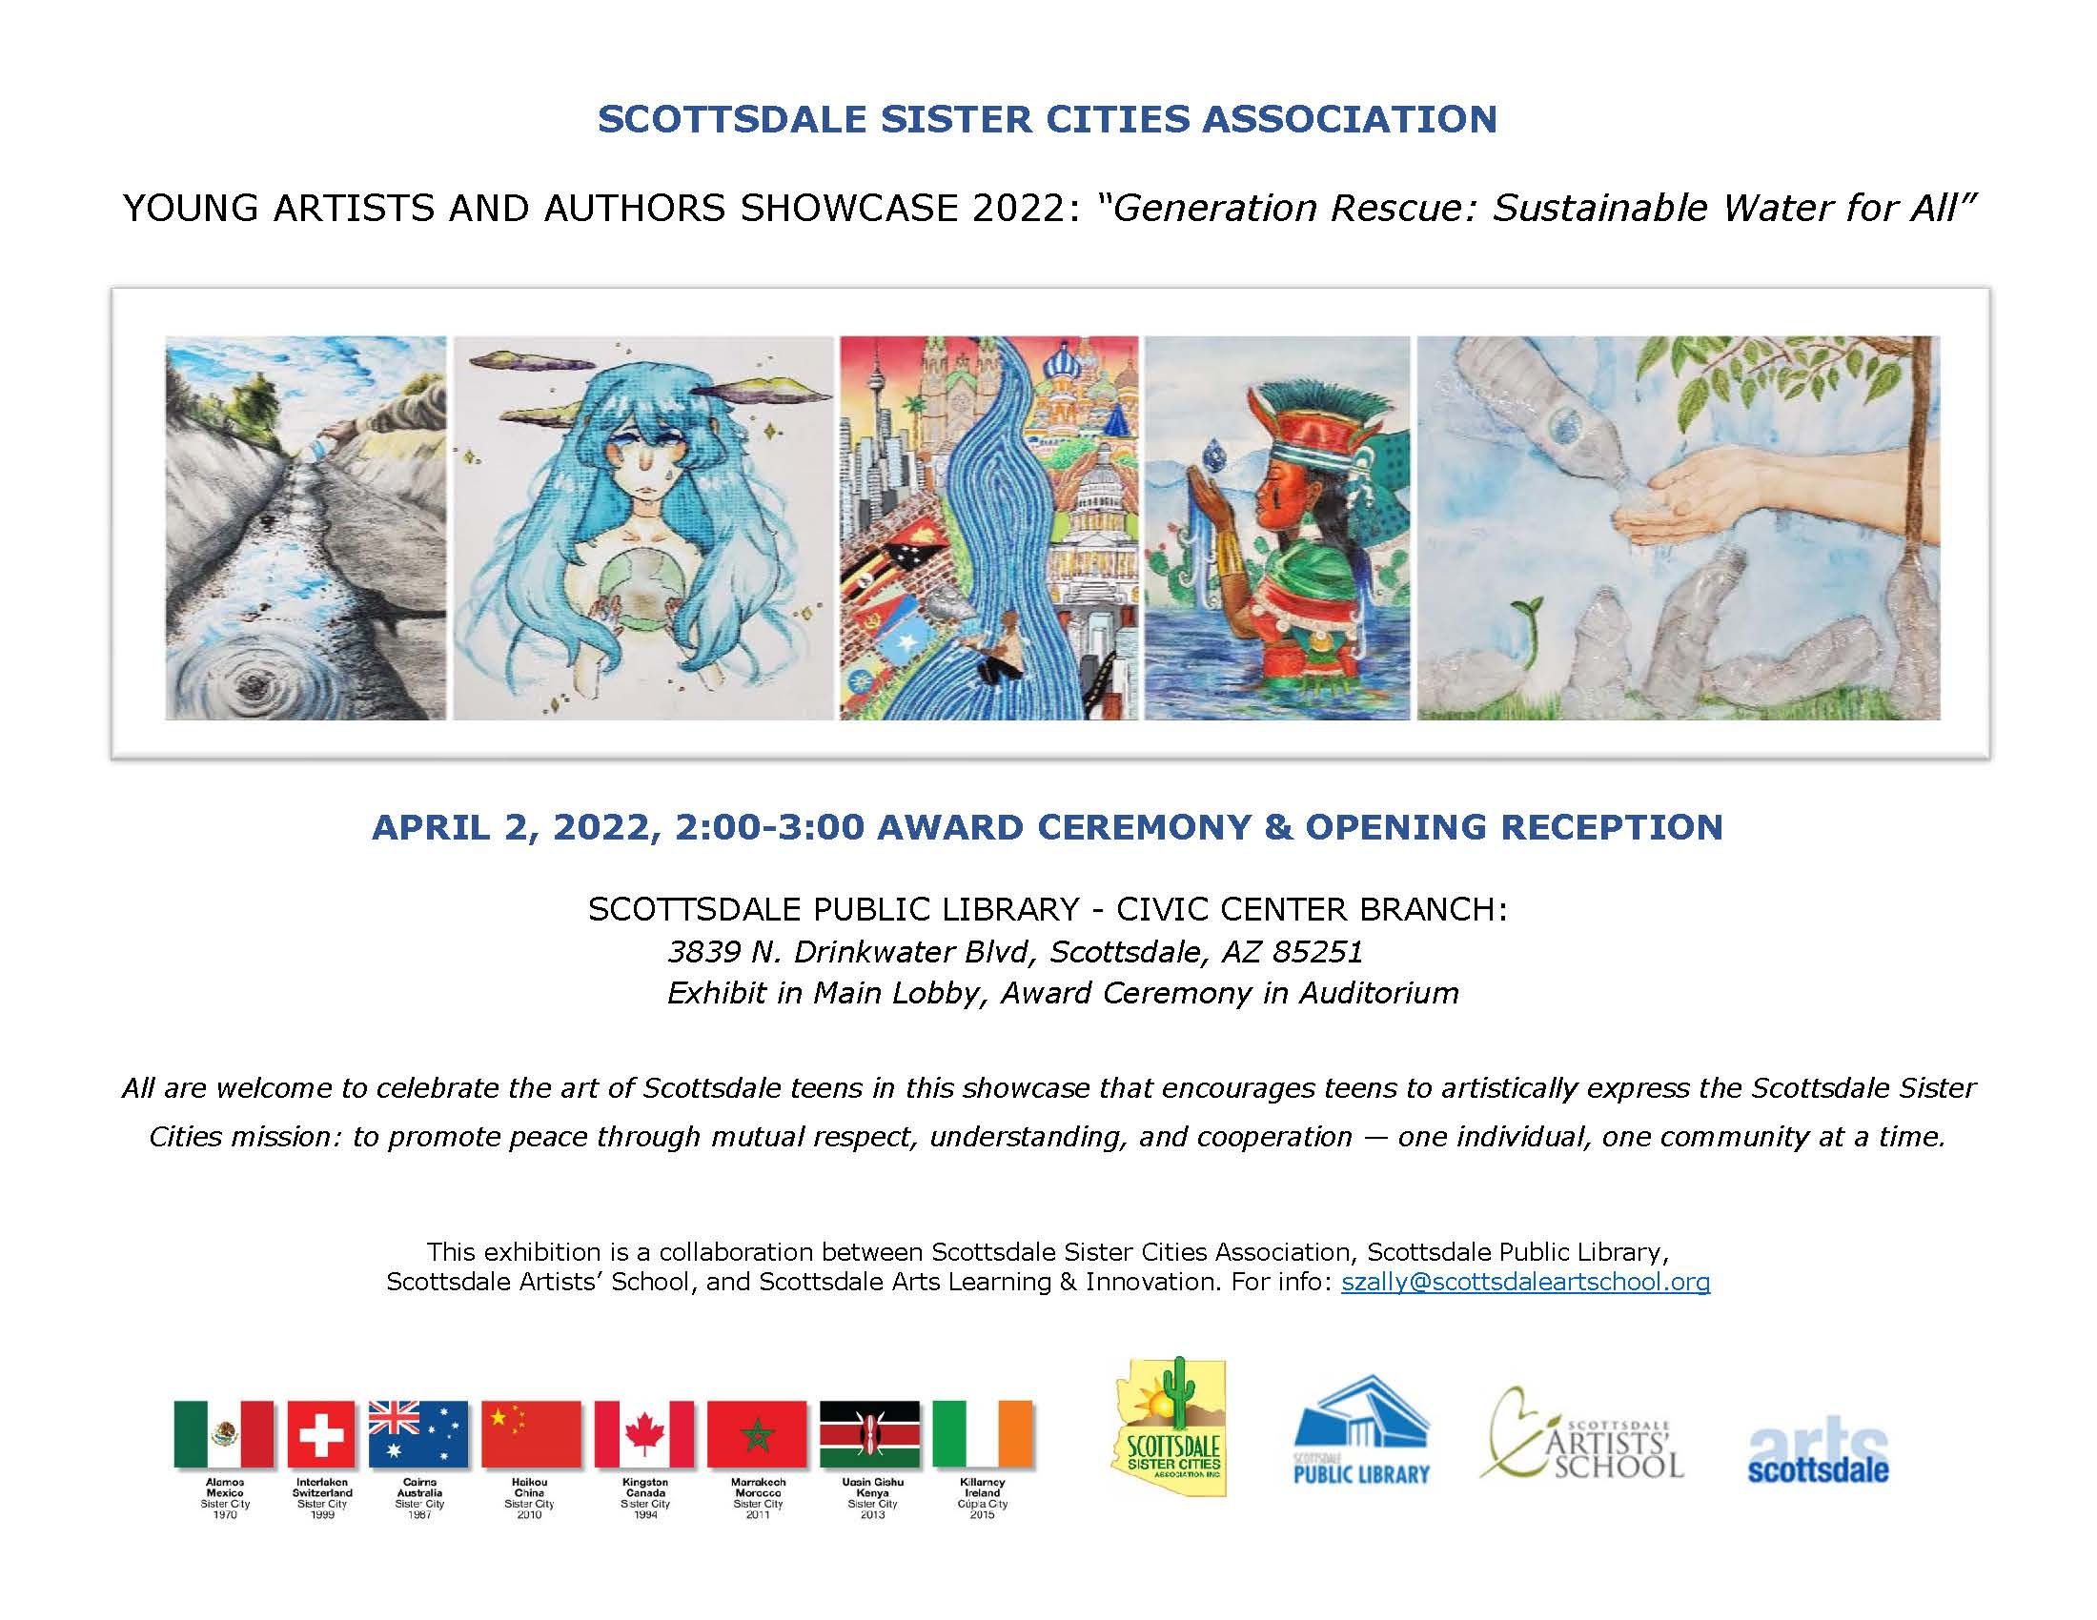

Slide 2
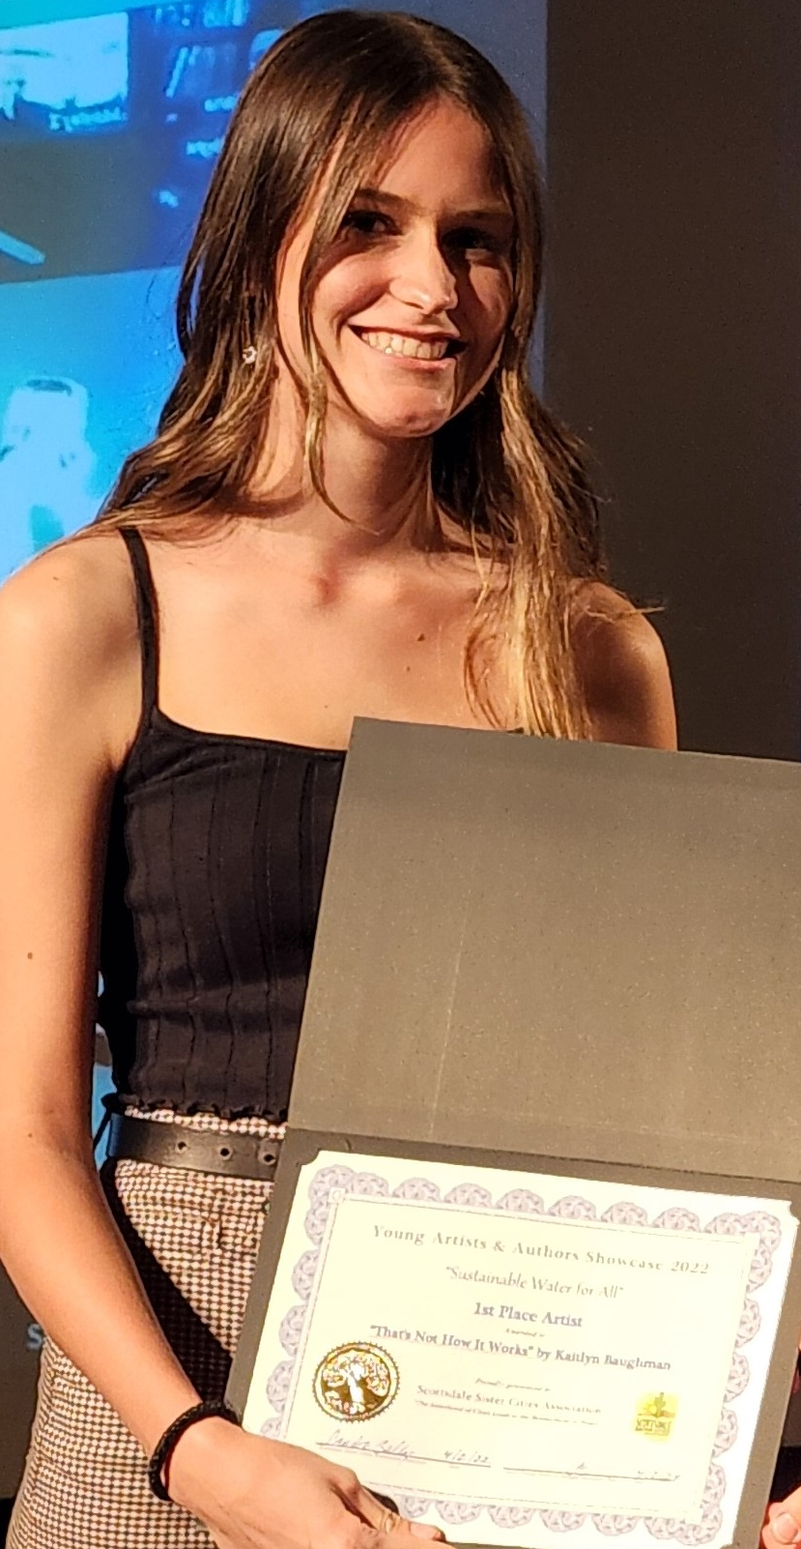
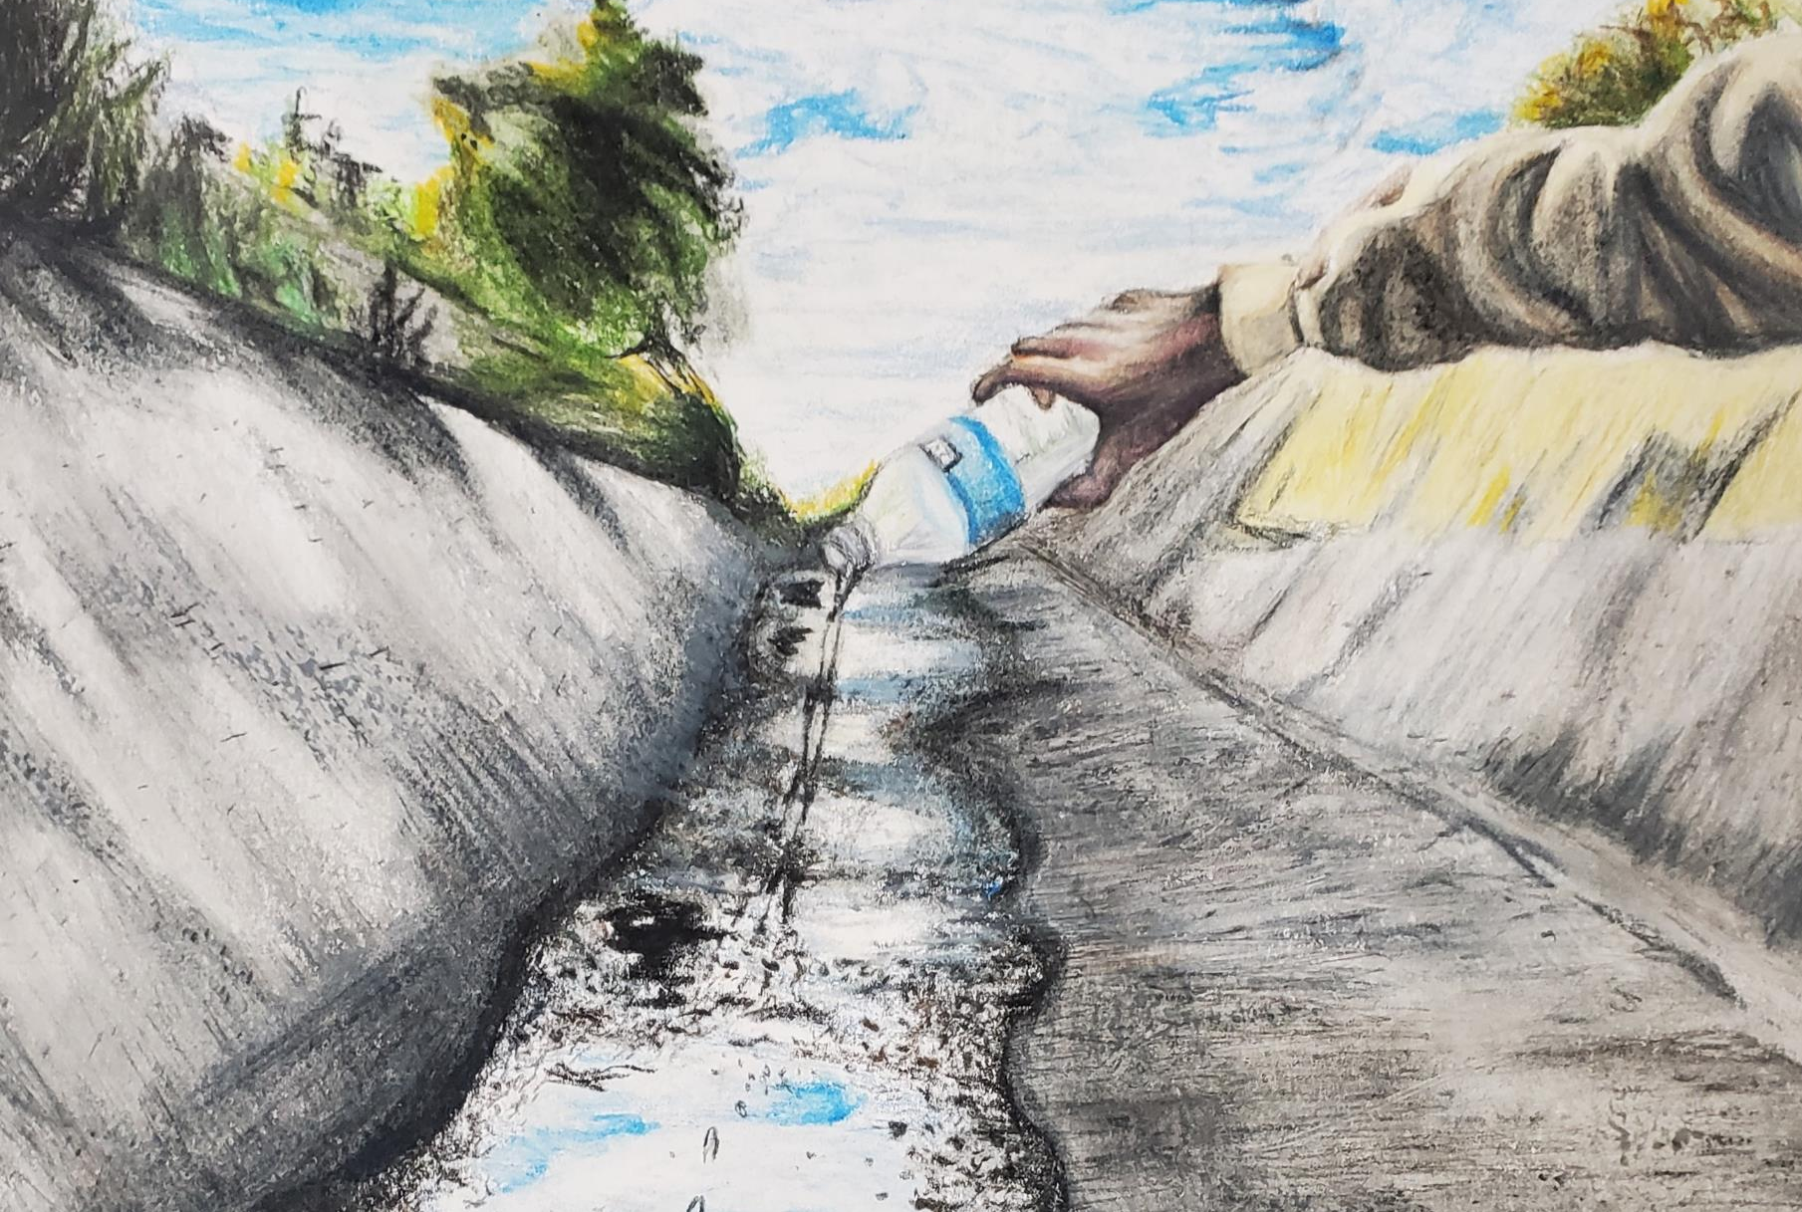
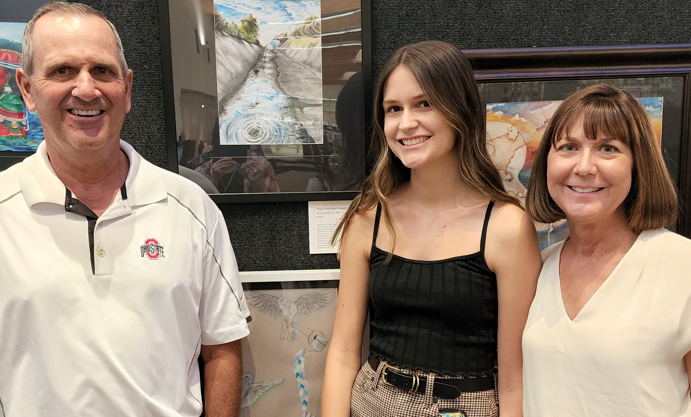
“That’s Not How It Works” Color Pencil
Kaitlyn Baughman
Age 17
1st Place
Chaparral High School
“My piece was highly inspired by the depletion of aquifiers. AZ retrieves much of its water from local aquifiers. Aquifiers are special in that the water is filtered as it seeps into the ground. However, once an aquifier is depleted, it cannot be refilled. I chose to draw an empty canal as a representation. While the implication that the demand for water bottles is what drained the canal in the first place, my drawing depicts a person desperately trying to replenish a dried-up canal with a water bottle. But that's not how it works. My piece is meant to display the irony of using man's solution instead of looking towards nature.”

Slide 3
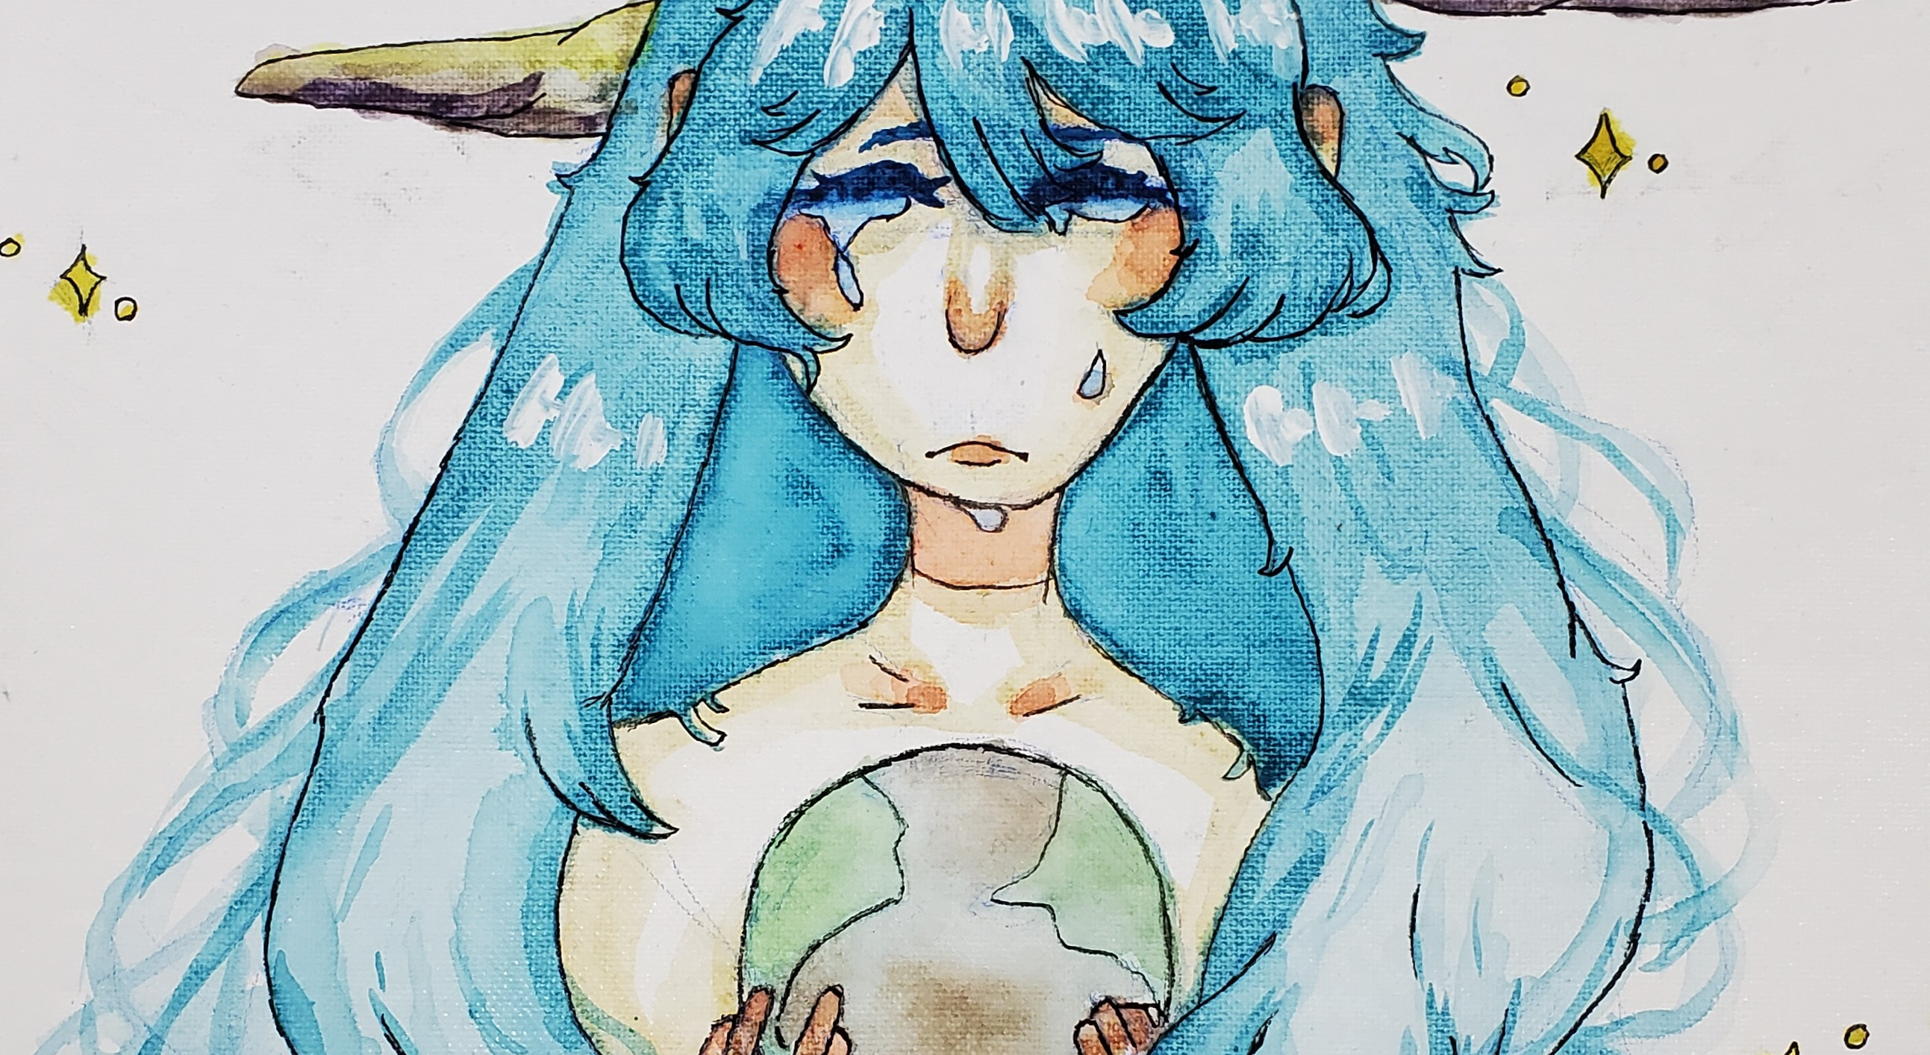
2nd
Place
“When
It Comes
To Water”
Acrylic Paint
Color Pencil
Elyse Lynnae Soller
Age 14
“Water is polluted and being used quickly. Someday I believe the water might be brown
and dangerous
to use.”

Slide 4
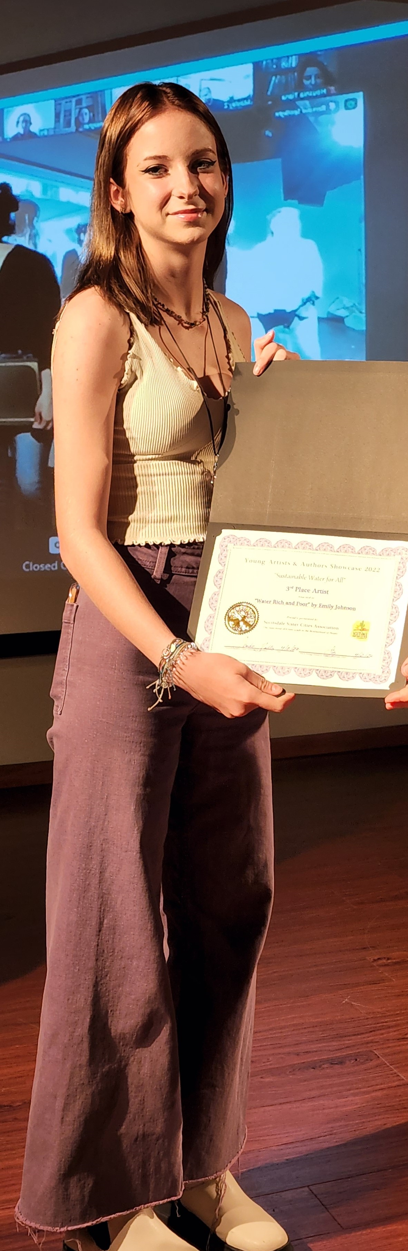
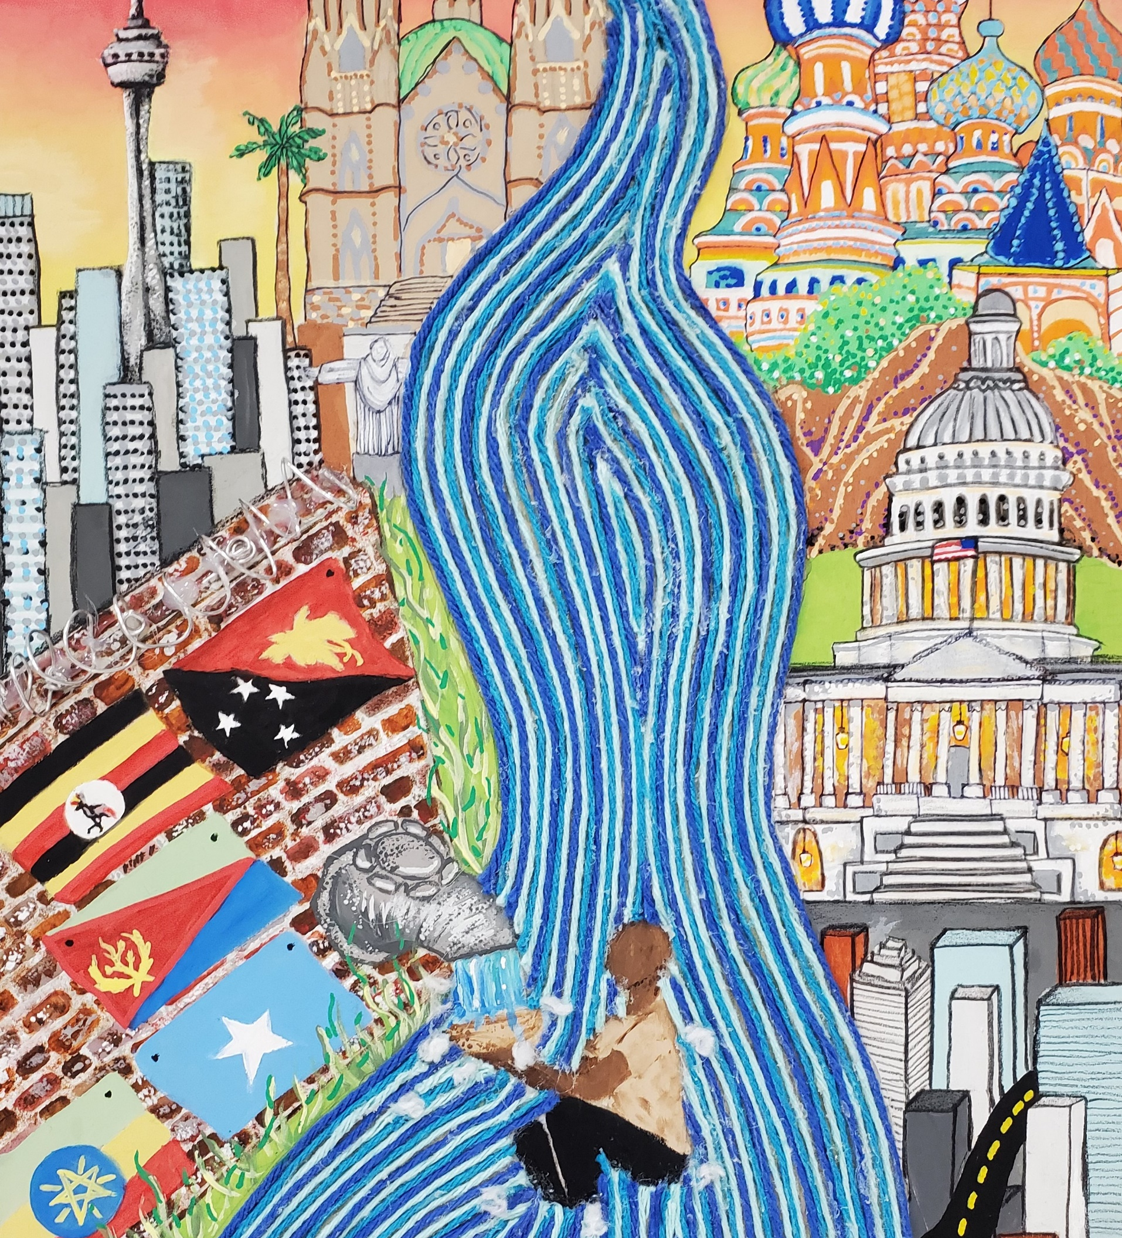
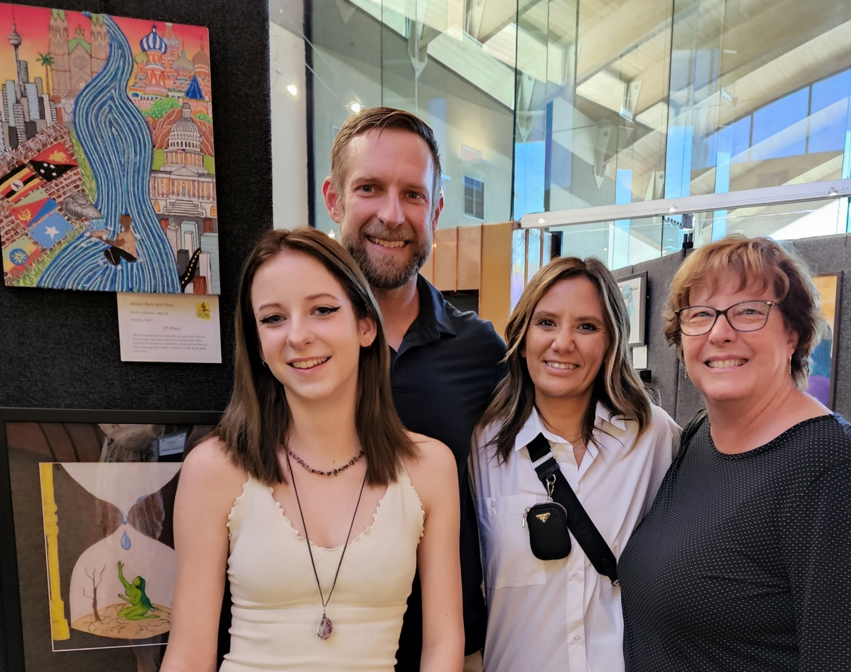
Emily Johnson, Age 16
3rd Place
“Water Rich & Poor”
Acrylic, Yarn, Wood
“What inspired me to create this artwork was the fact that certain countries have more sustainable water available than others. I wanted to illustrate the idea of water flowing from richer countries to the more poor countries.”
Saguaro High School

Slide 5
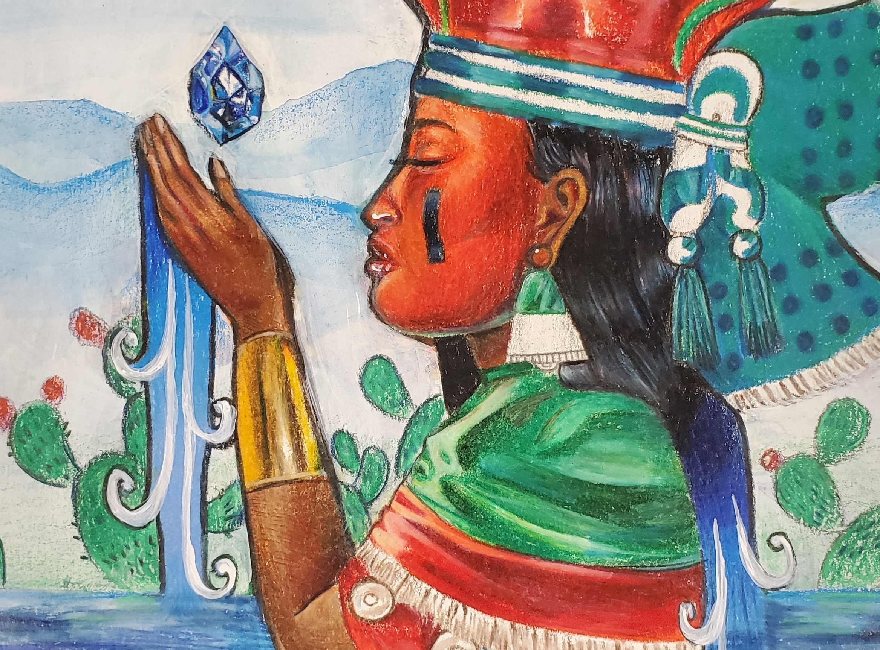
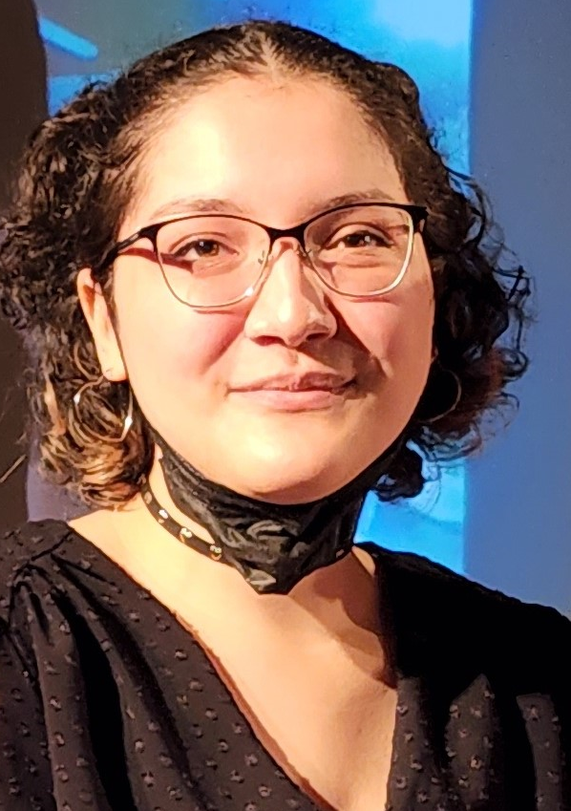
Diana Lopez, Age 17
Oración A Chalchiuhtlicue
Acrylic, Color Pencil
4th Place
Desert Mountain
High School, Scottsdale
“As a Mexican-American, I am influenced by my culture and background as well as my community in Scottsdale, Arizona. I take great pride in my indigenous roots and wanted to highlight the significant role native communities have in conservation and sustainability efforts.
The piece depicts Chalchiuhtlicue - the Nahua goddess of springs, rivers, and streams - holding a gem. The gem reflects the preciousness of water and behind her are the mountains, sky, and plants which all depend on water and we as humans depend on for survival. I wanted to show not only the importance of water sustainability but also the important culture and people behind conservation efforts.”

Slide 6
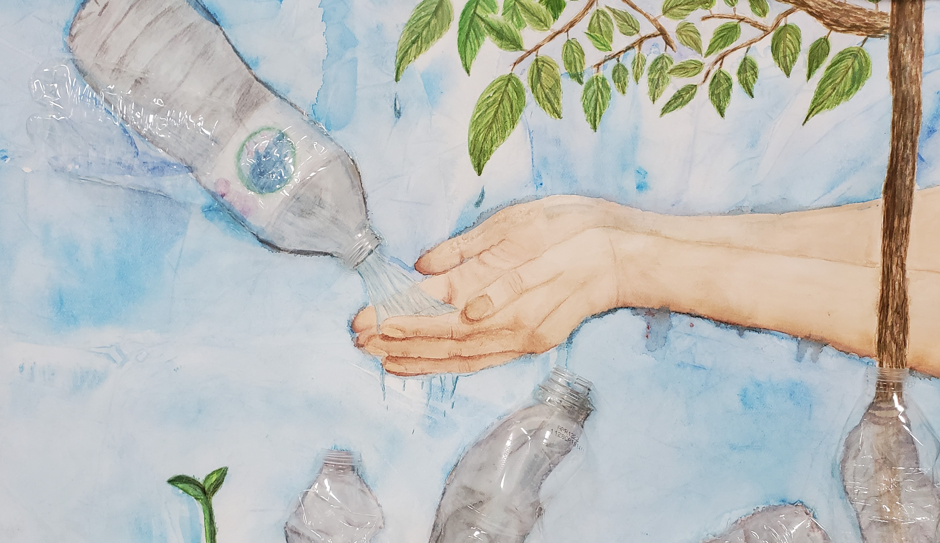
Harper Harris
Age 16
5th Place
“Nature Combating Humans”
Watercolor, Water Bottles
“What inspired me was the difference between needless waste versus waste that needs to happen, such as plastic water bottles given to people who don't have access to clean water. With that I also wanted to show nature's impact and importance, as plants grow from these water bottles.”
Saguaro High School

Slide 7
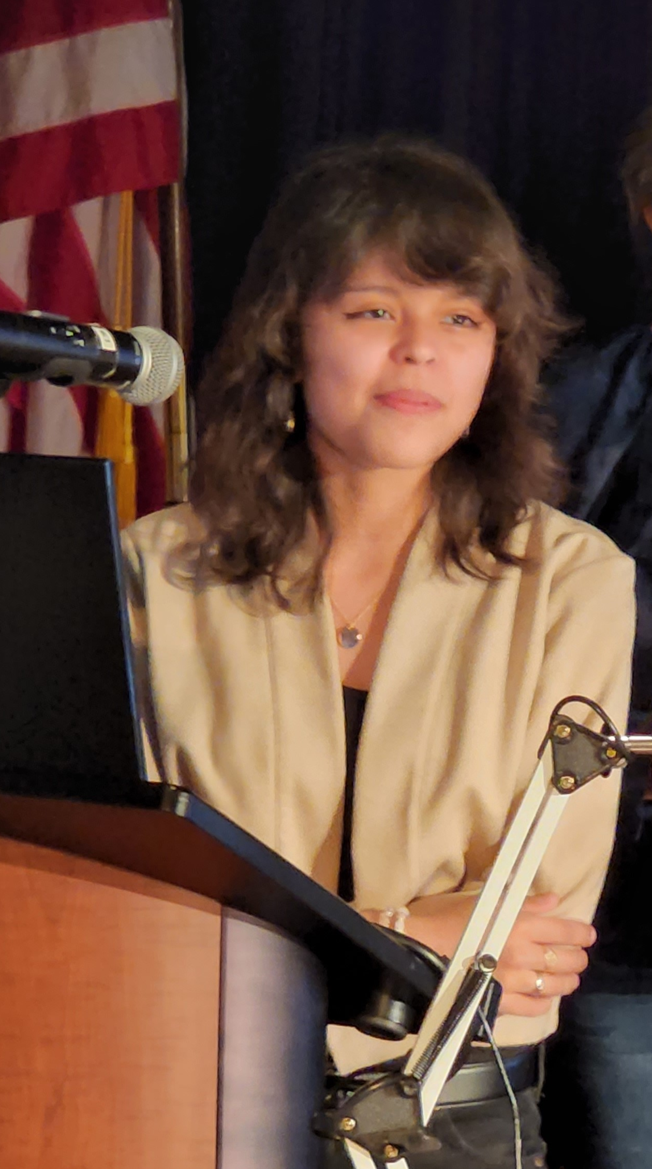
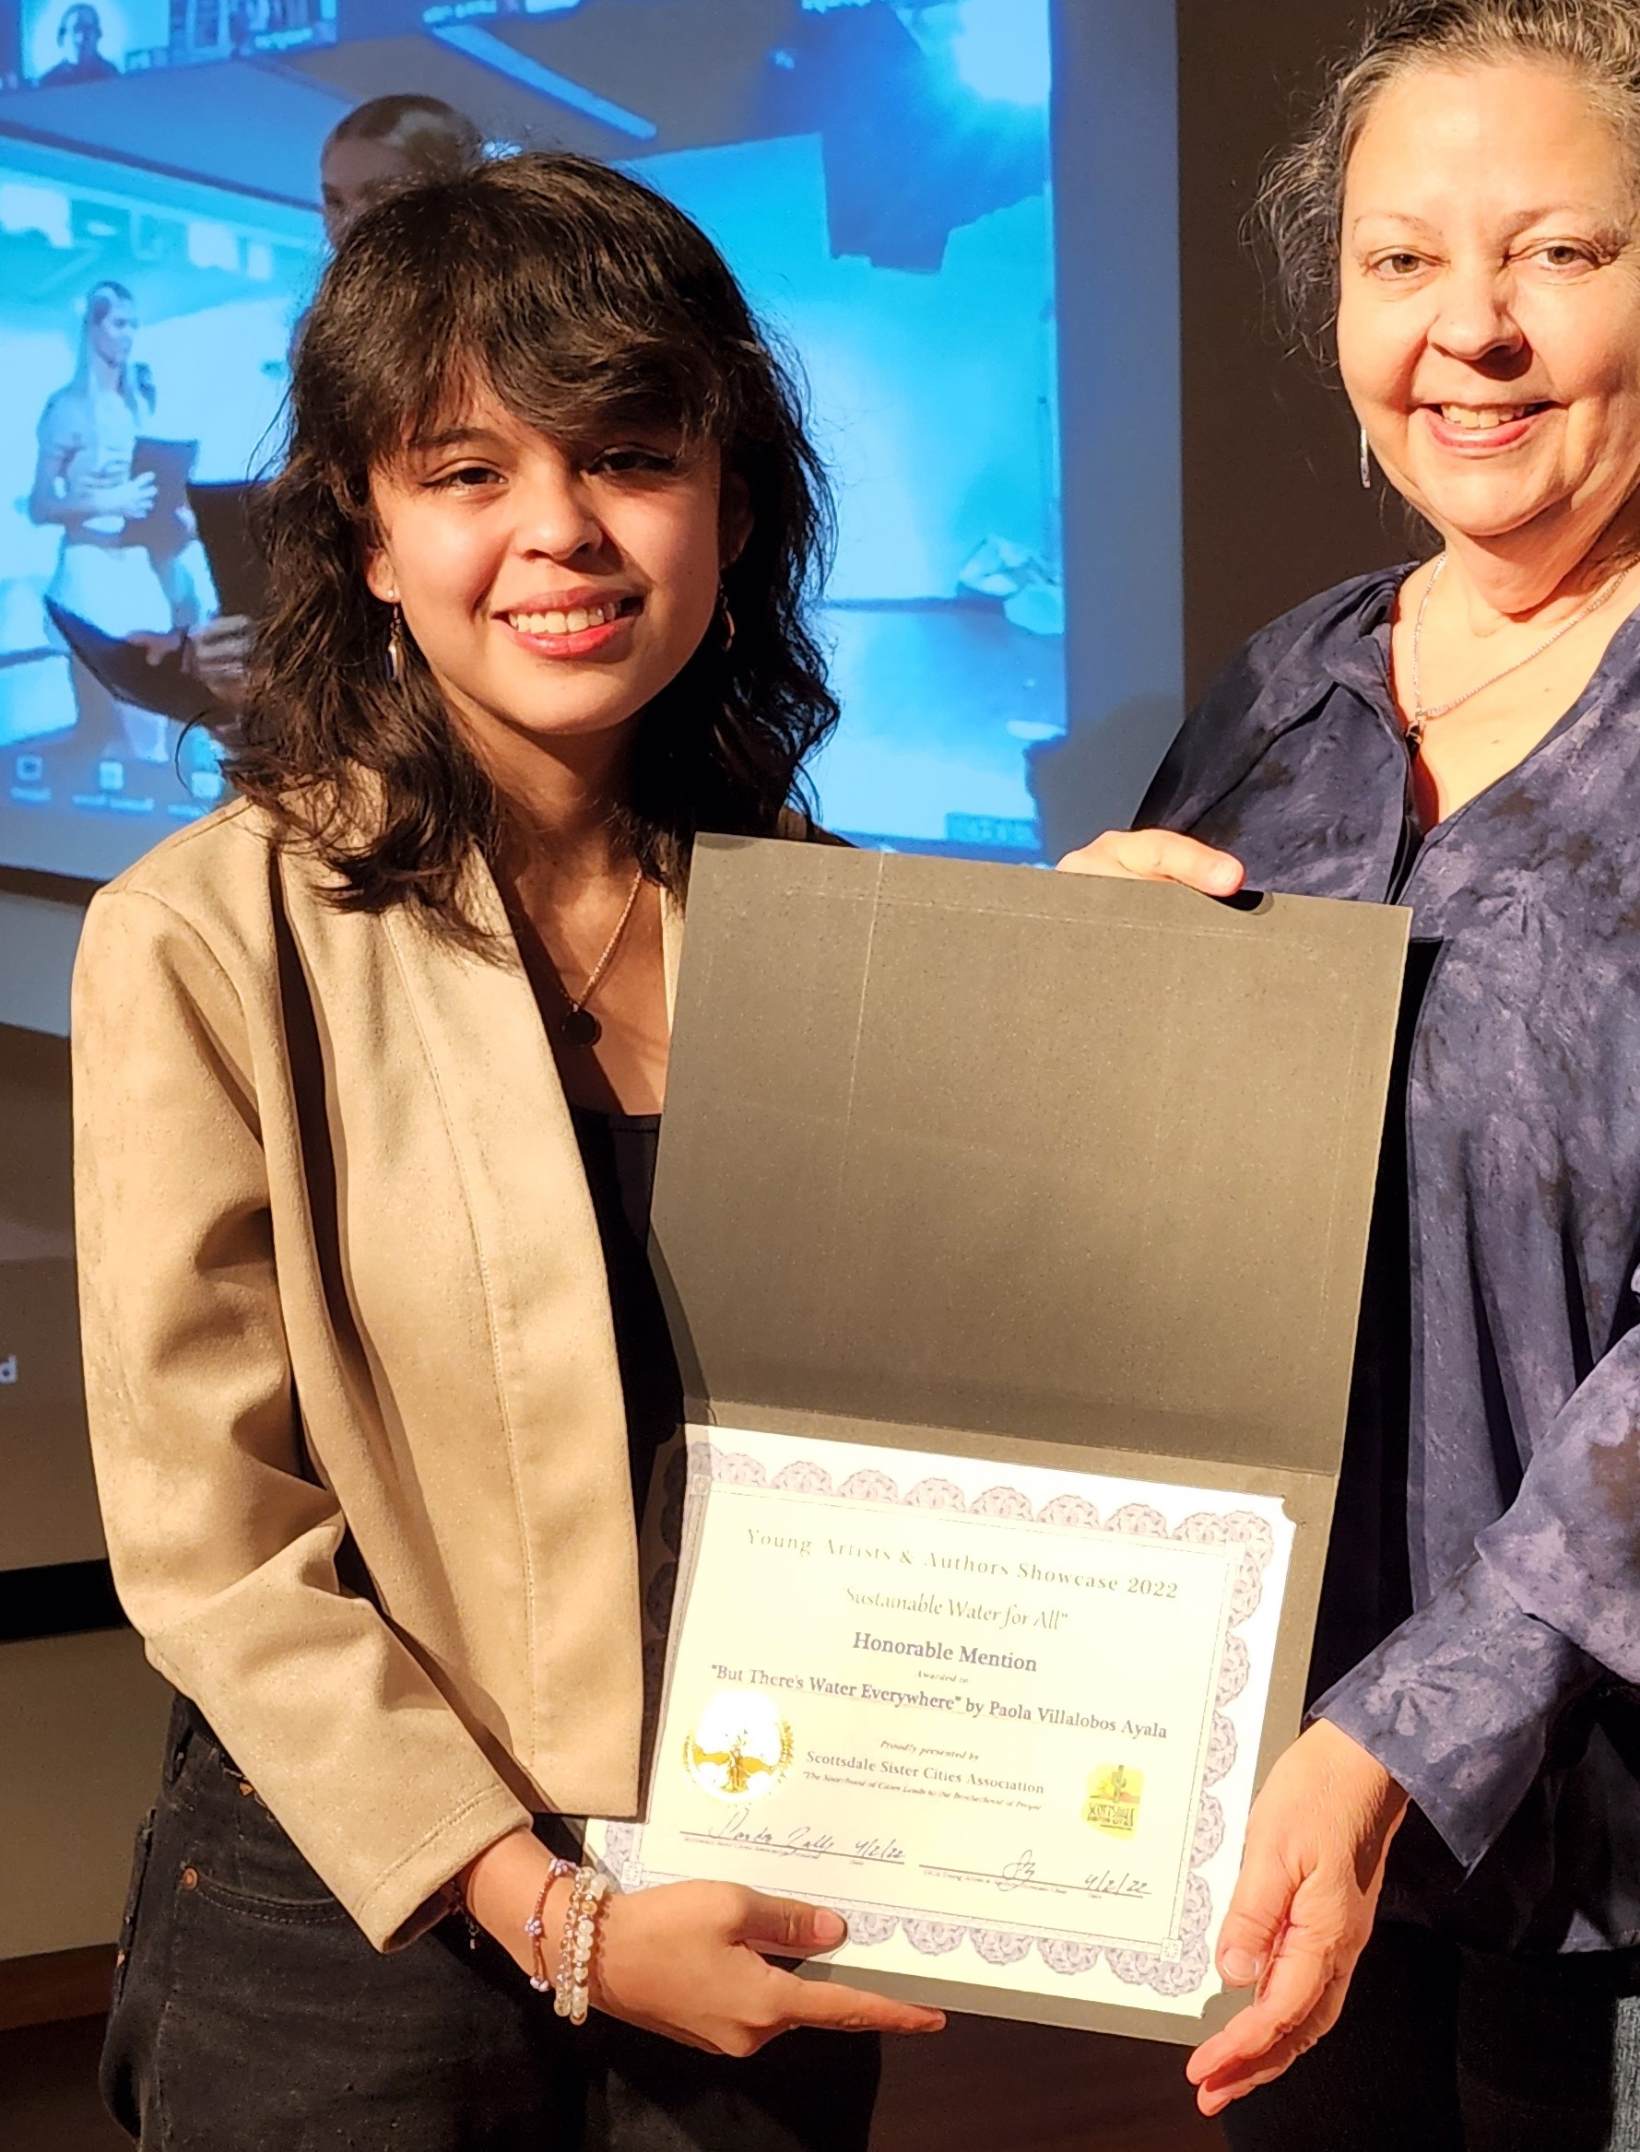
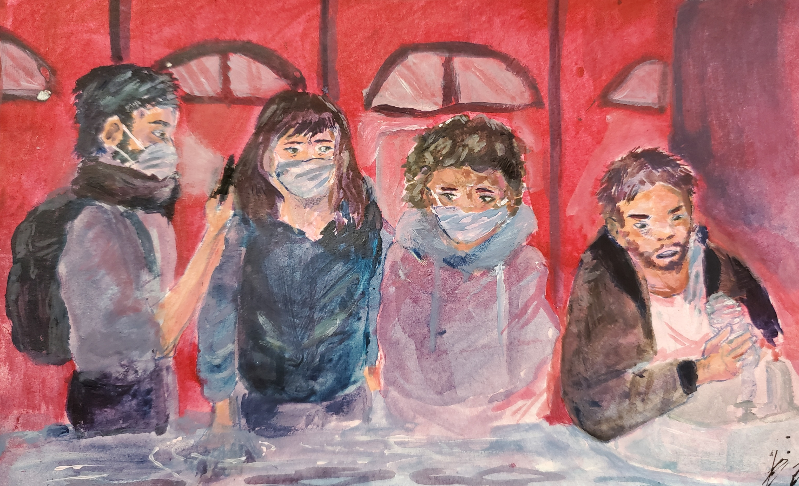
“But There’s Water Everywhere”
Color Pencil
"We are seeing the decline of our planet happening around us, when we go outside, we see and feel the effects of climate change at our doorstep. Soon enough we will feel it on our ankles, and our knees, and all the way up to our thighs. Water and its importance is a double edged sword.”
Paola Villalobos, Age 17
Honorable Mention
Desert Mountain High School

Slide 8
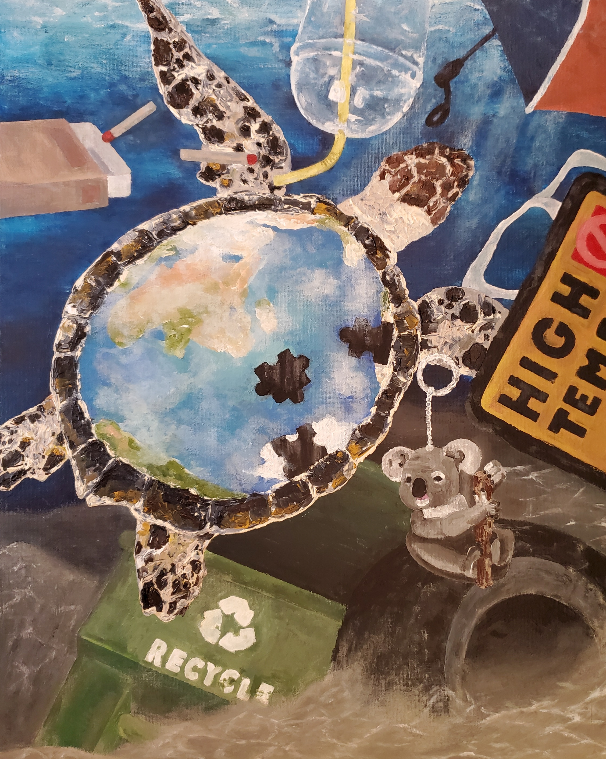
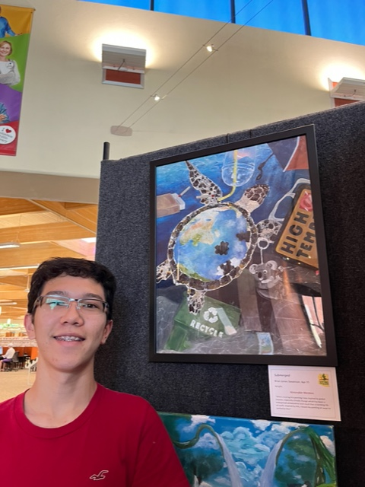
Brian James Stevenson
Age 15
Honorable Mention
“Submerged”
Acrylic
“When creating this painting I was inspired by global impacts, especially climate change which has been a widespread consequence and result that is harming life on earth. Inspired by this, I based my painting on ways to symbolize this.”
Saguaro High School

Slide 9
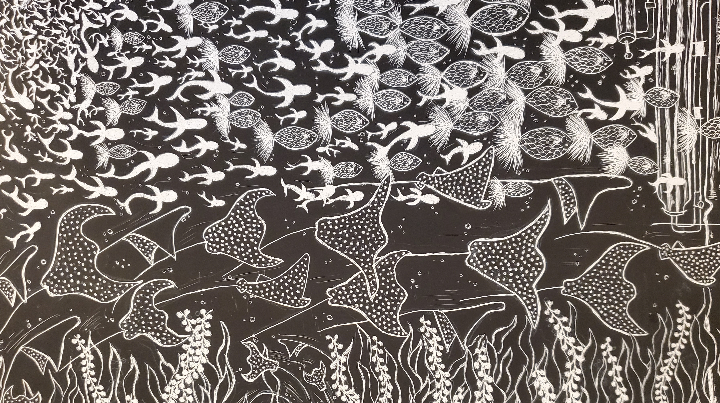
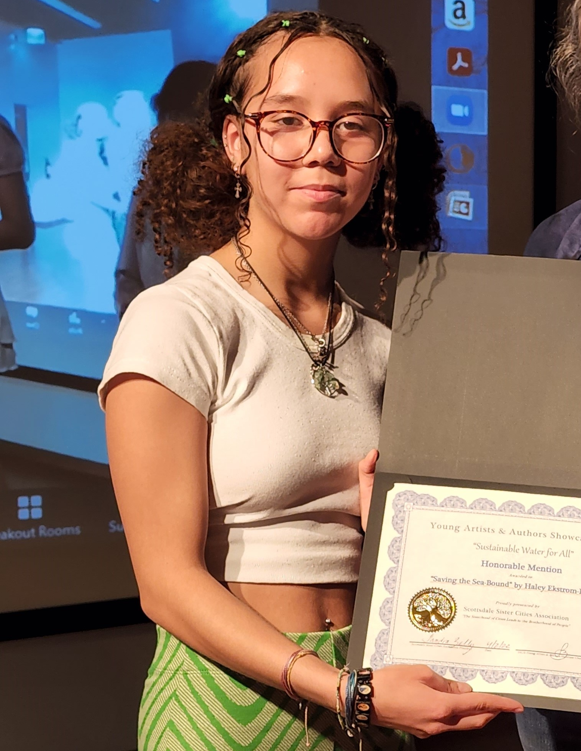
Haley Ekstrom Leveque
Age 17
Saguaro High School
Honorable Mention
“Saving the Sea Bound”
Scratchboard
“My Inspiration to create this work came from my strong passion for ocean life, and my strong love for stingrays. While I was in my class, I was looking around at other people's artwork and I noticed something huge. When people hear about sustainable water for all, people don't usually think about ocean life. I also realized that clean water is important for not just people, and land life, but to sea life.”

Slide 10
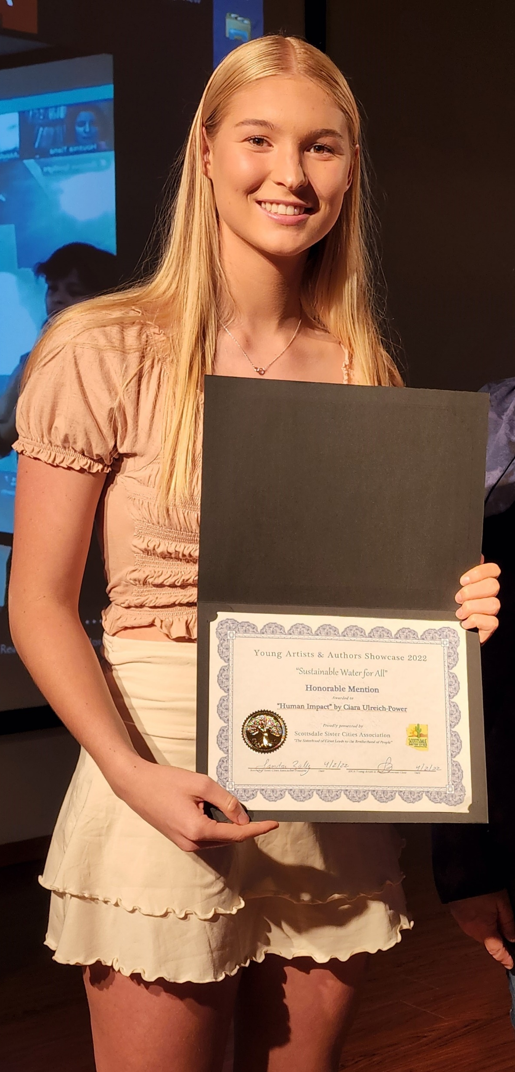
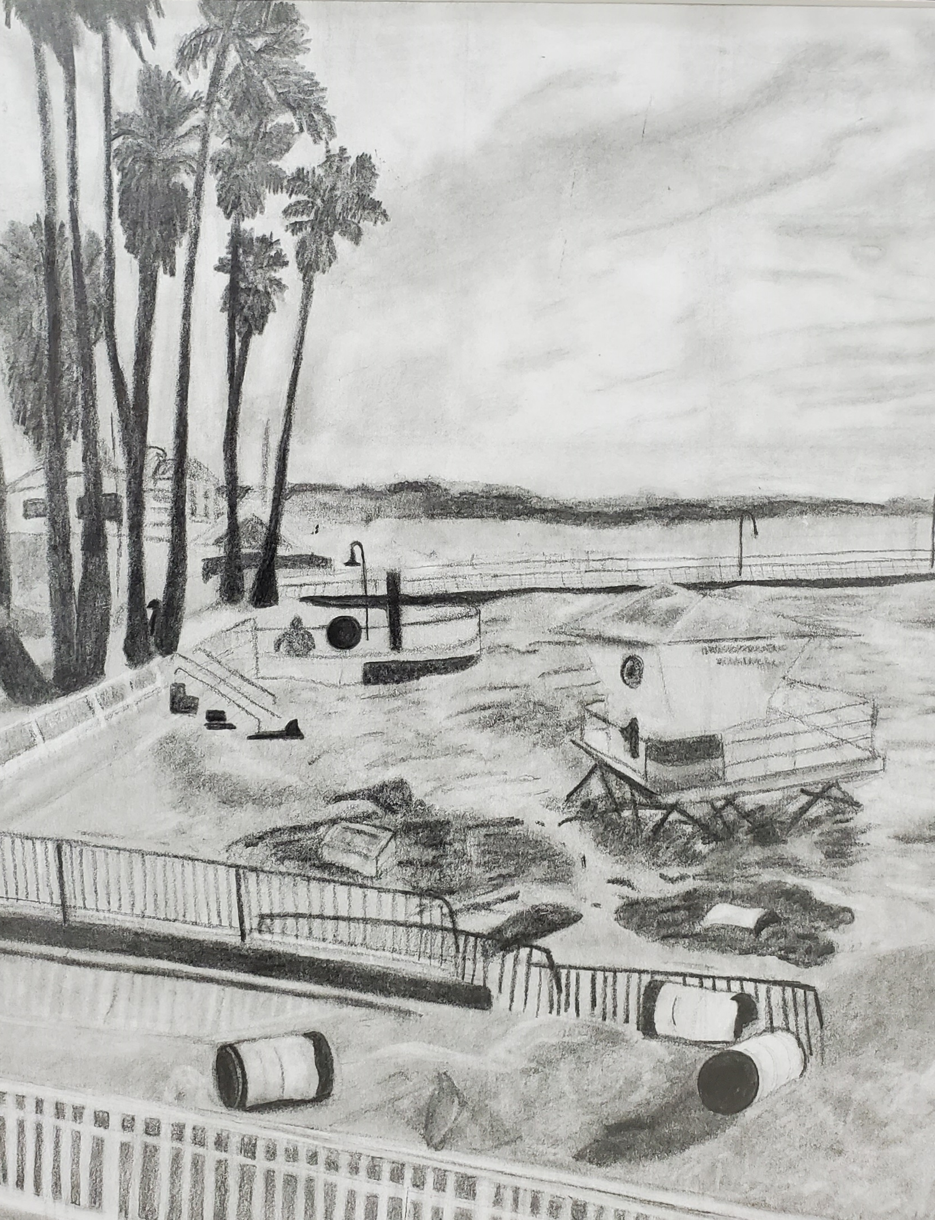
Ciara Ulreich-Power
Age 17
Honorable Mention
“Human Impact”
Pencil
"Humans have affected the earth since our existence. Humans are irresponsible and tend not to care about their actions and their effects on the earth. Climate change is a serious issue that needs to be addressed more often, and I hope this art will help express my view and spread the message.”
Chaparral High School

Slide 11
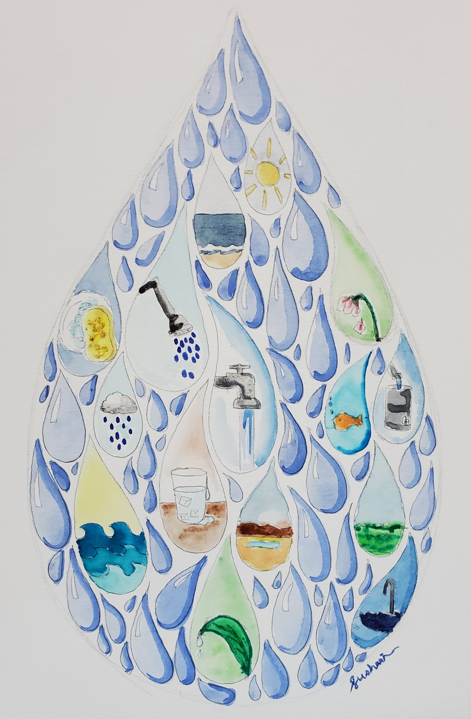
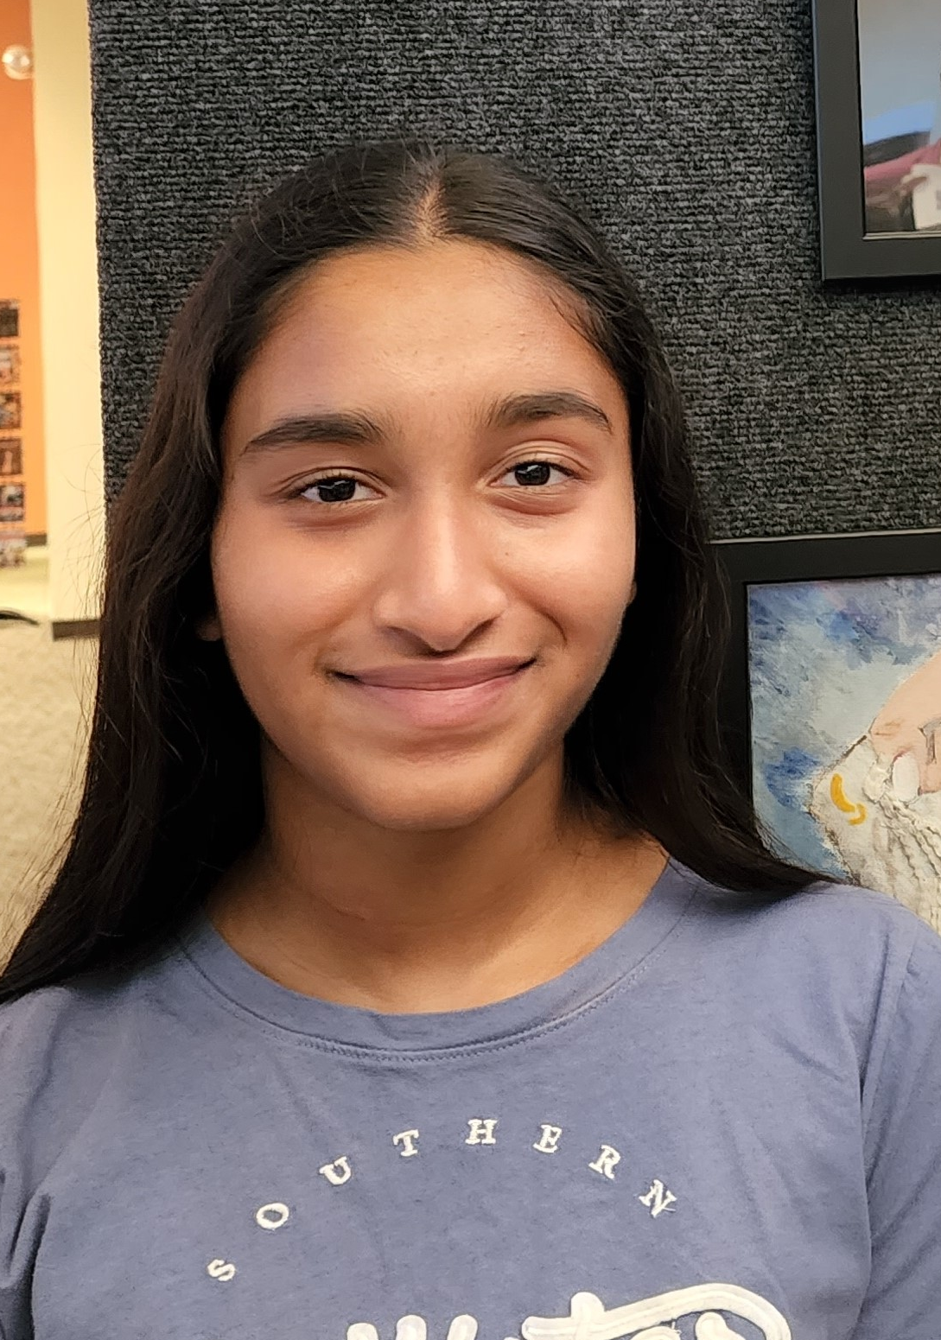
Sushmita Marella
Age 14
Honorable Mention
“Holy Grail of Drop”
Watercolor
“Water is one of the world's most valuable resources. Therefore, it is also one of the most used resources. Water is wasted on a daily basis since we require it for so many things. Together, we can protect our water by using it sparingly and preserving our resources.”

Slide 12
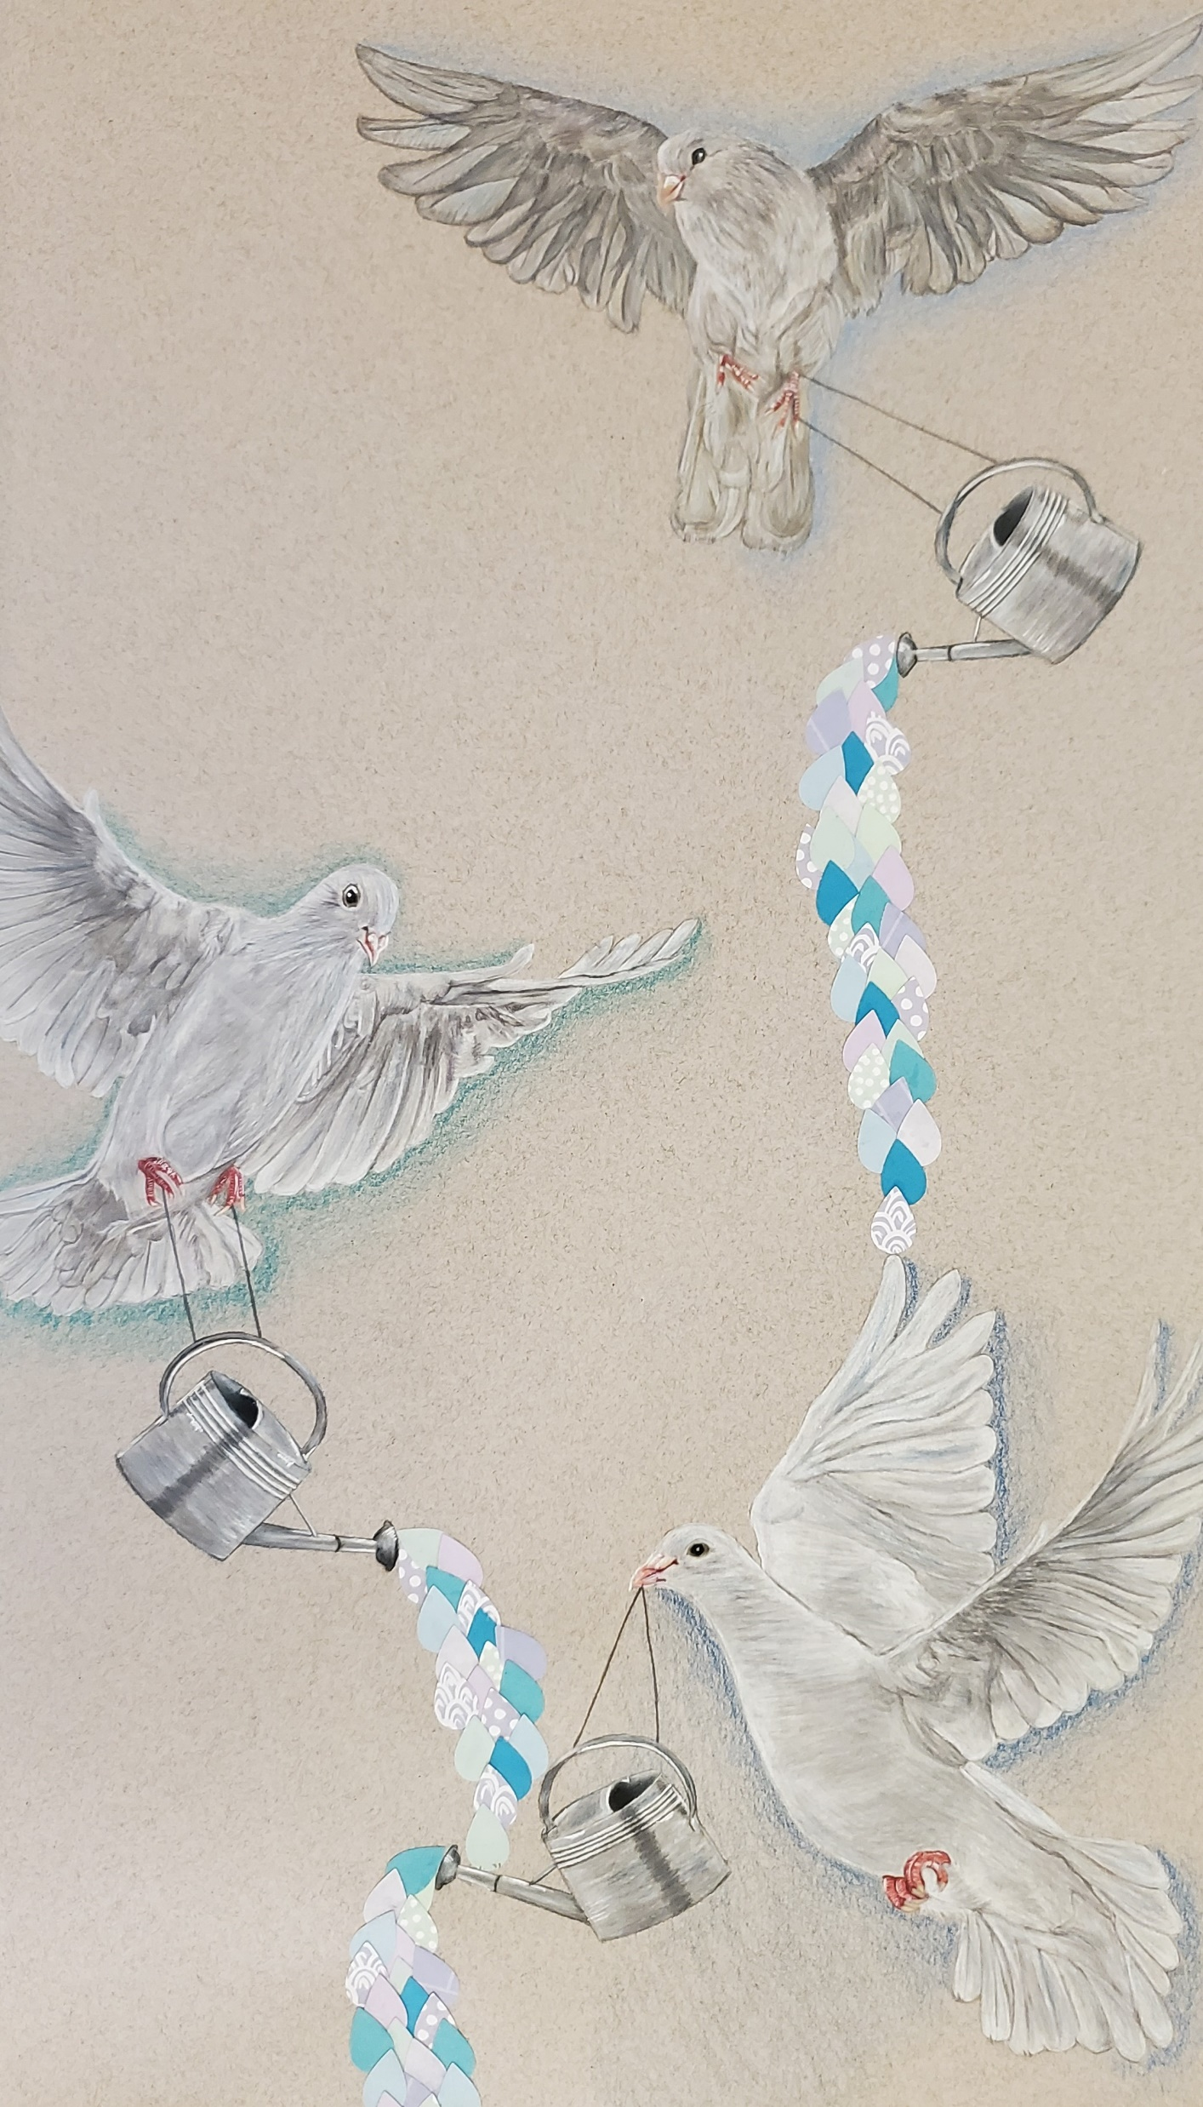
Katherine Dalton
Age 16
Honorable Mention
“Wings of Hope”
Color Pencil, Collage
“I wanted to create a piece that I felt reflected the theme of "Sustainable Water for All" I wanted to yse my favorite medium on this project, but I ended up pushing myself to use another medium as well. I also chose to include a form of an animal in it, because I love incorporating animals into my work.”
Saguaro High School

Slide 13
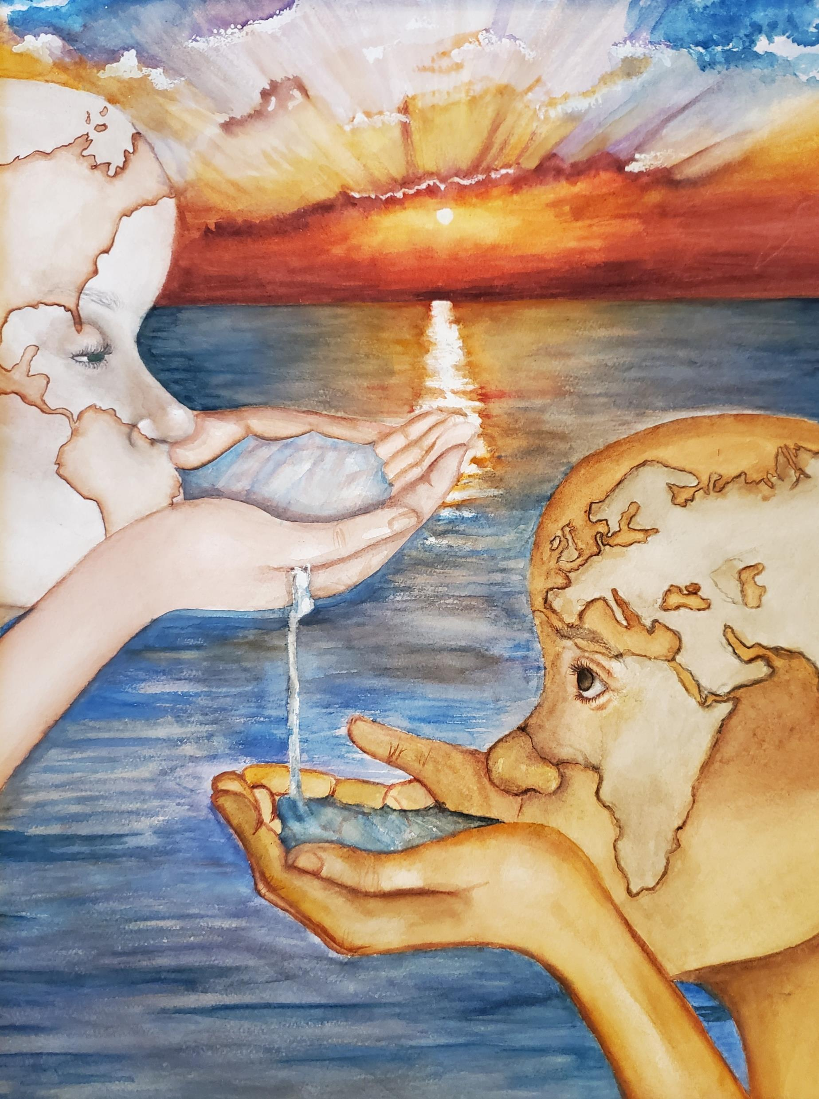
Aluet Gaxiola Vera
Age 18
Honorable Mention
“Map of Life”
Watercolor
“I've really been drawn to maps this year and realized how everyone is connected by water.”
Saguaro High School

Slide 14
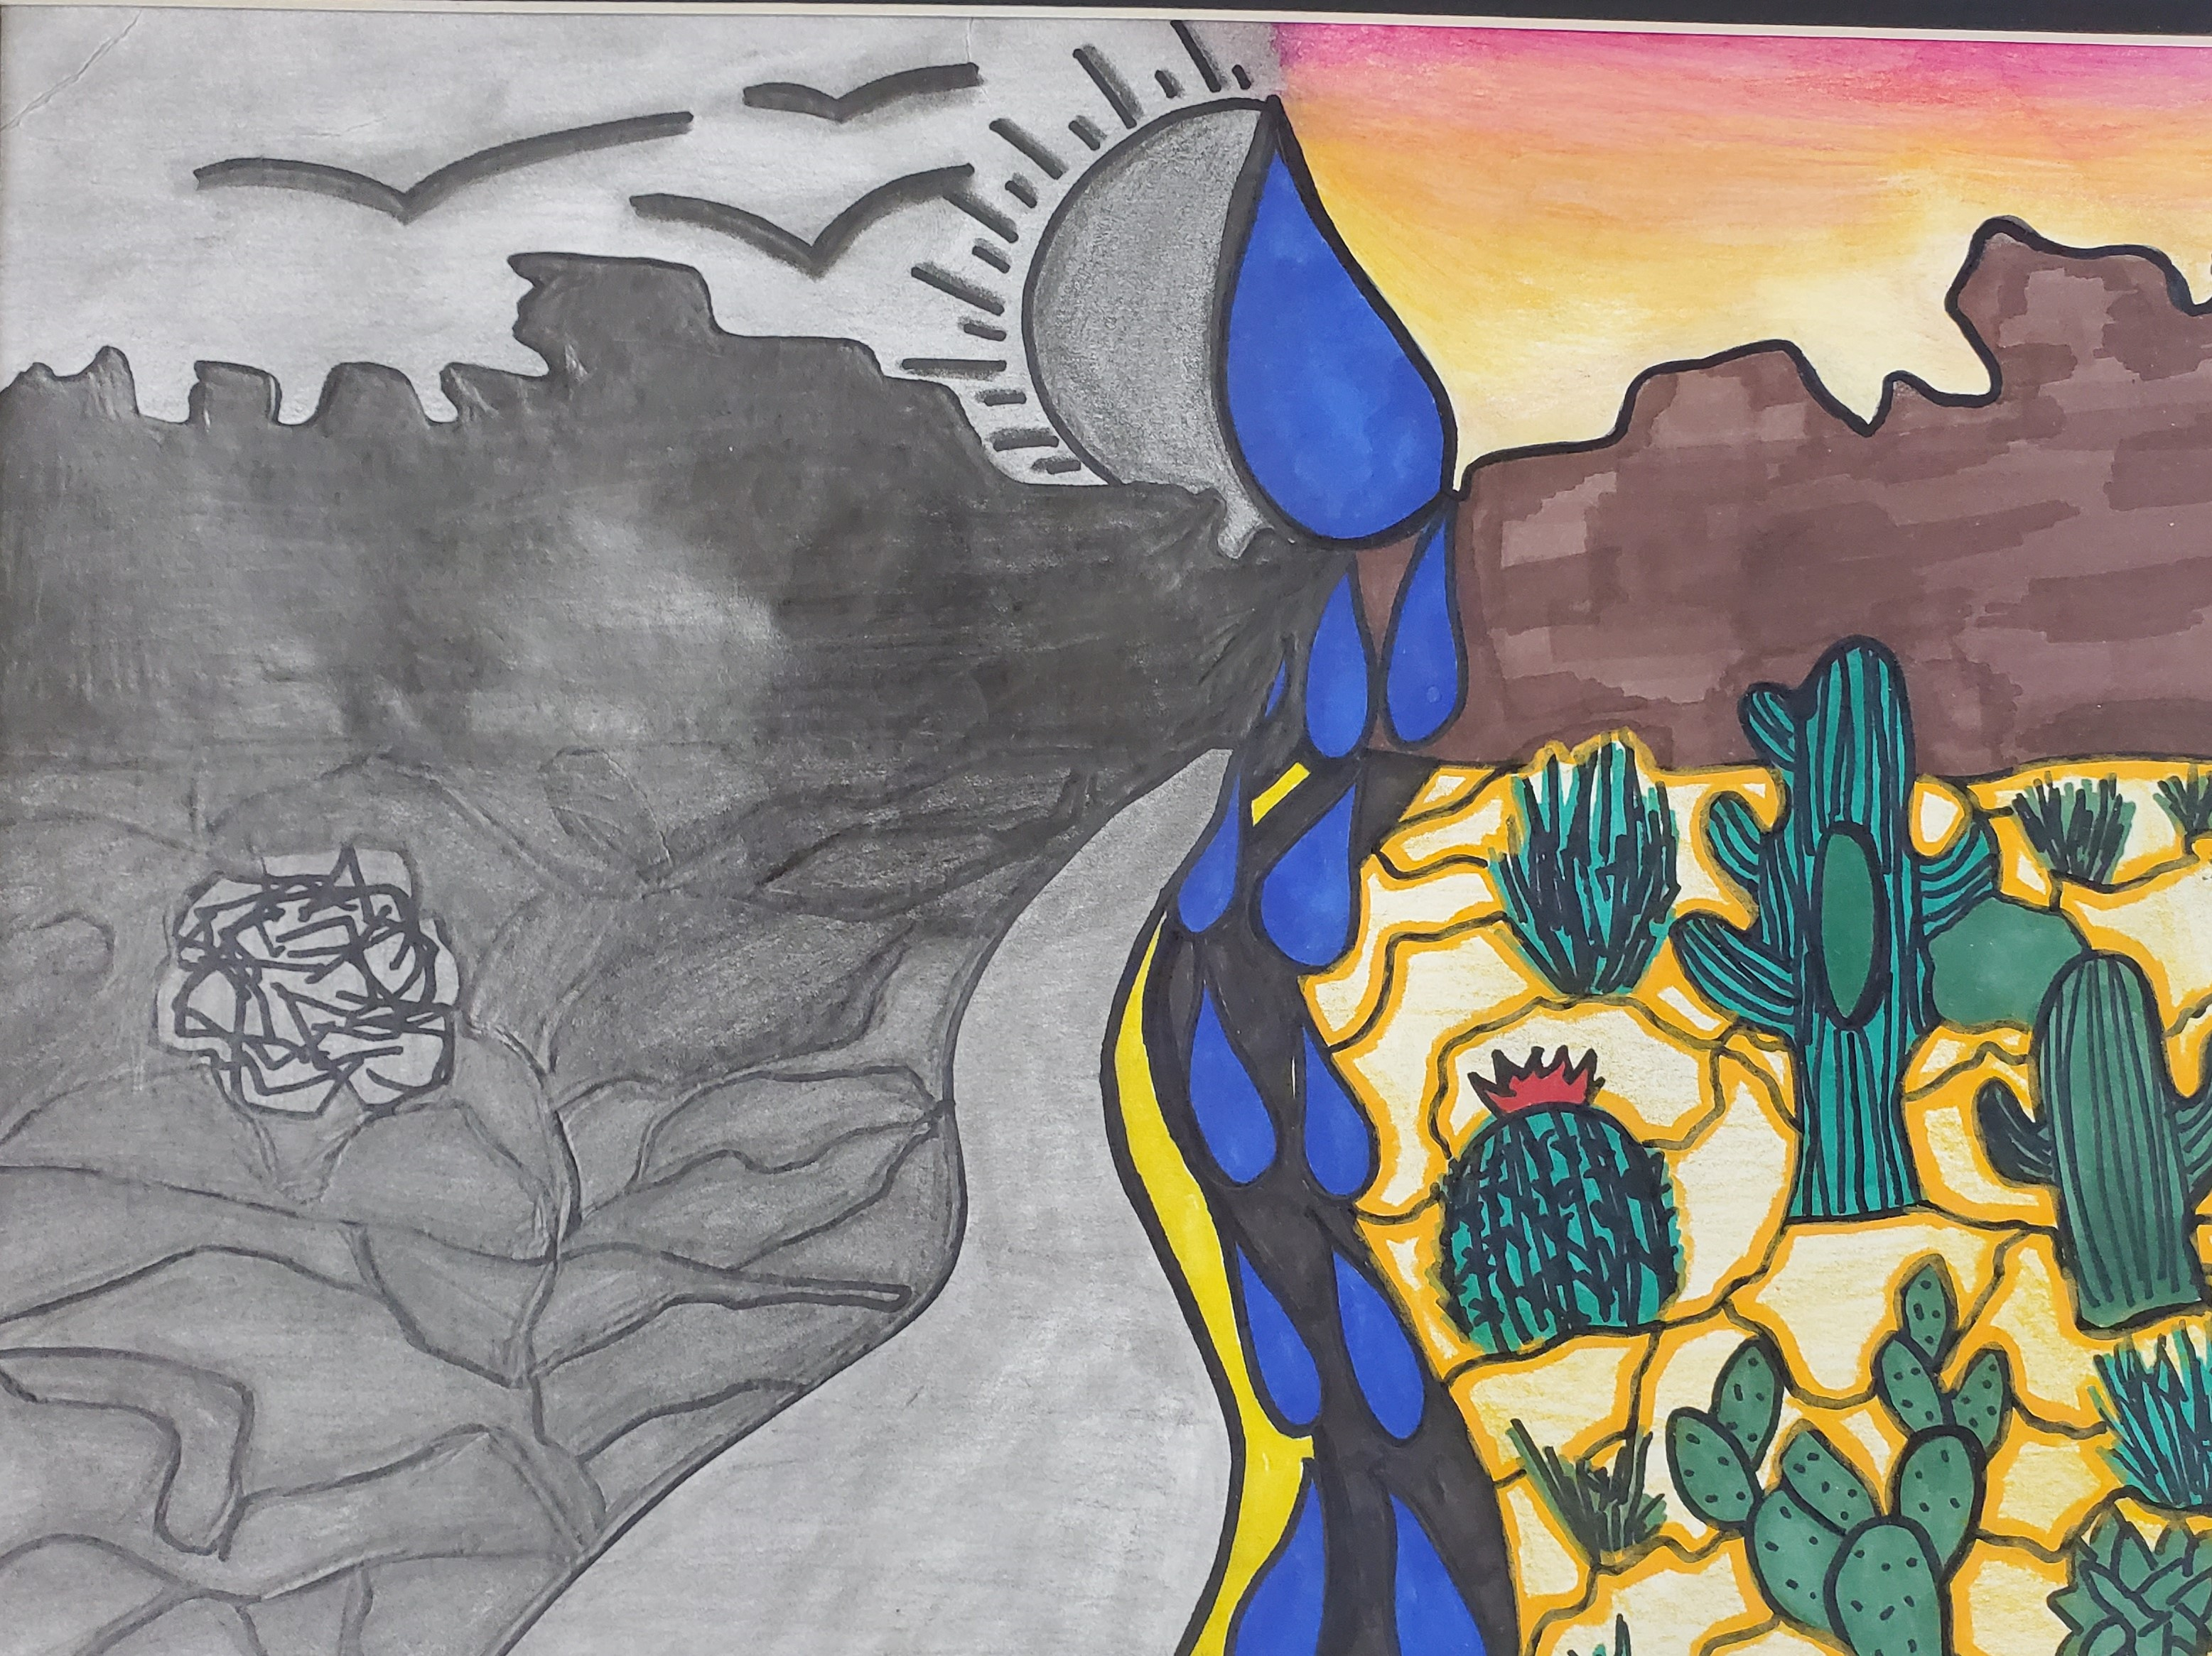
Holly Brooke Small
Age 17
Honorable Mention
“Desert Duo”
Marker, Color Pencil
“Arizona is a beautiful state but often looked over because of beaches in California. However, our desert is beautiful, and without water, we wouldn't be able to see what beautiful life it takes care of.”
Chaparral High School

Slide 15
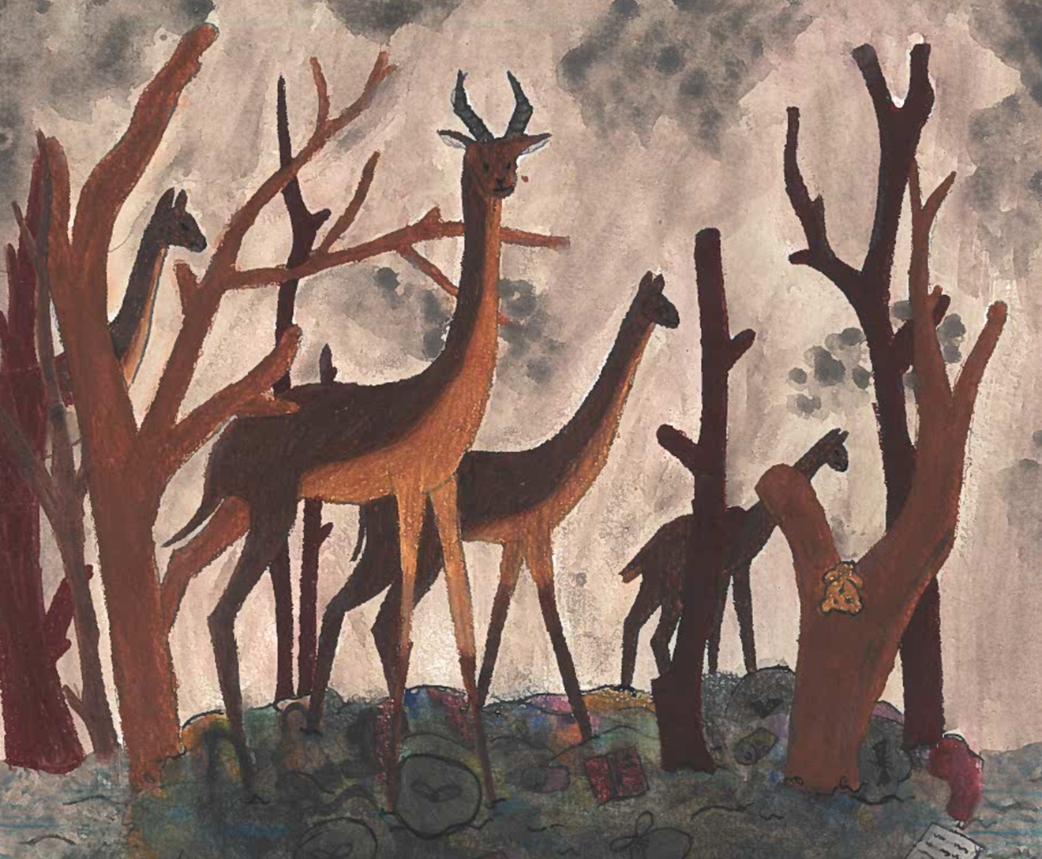
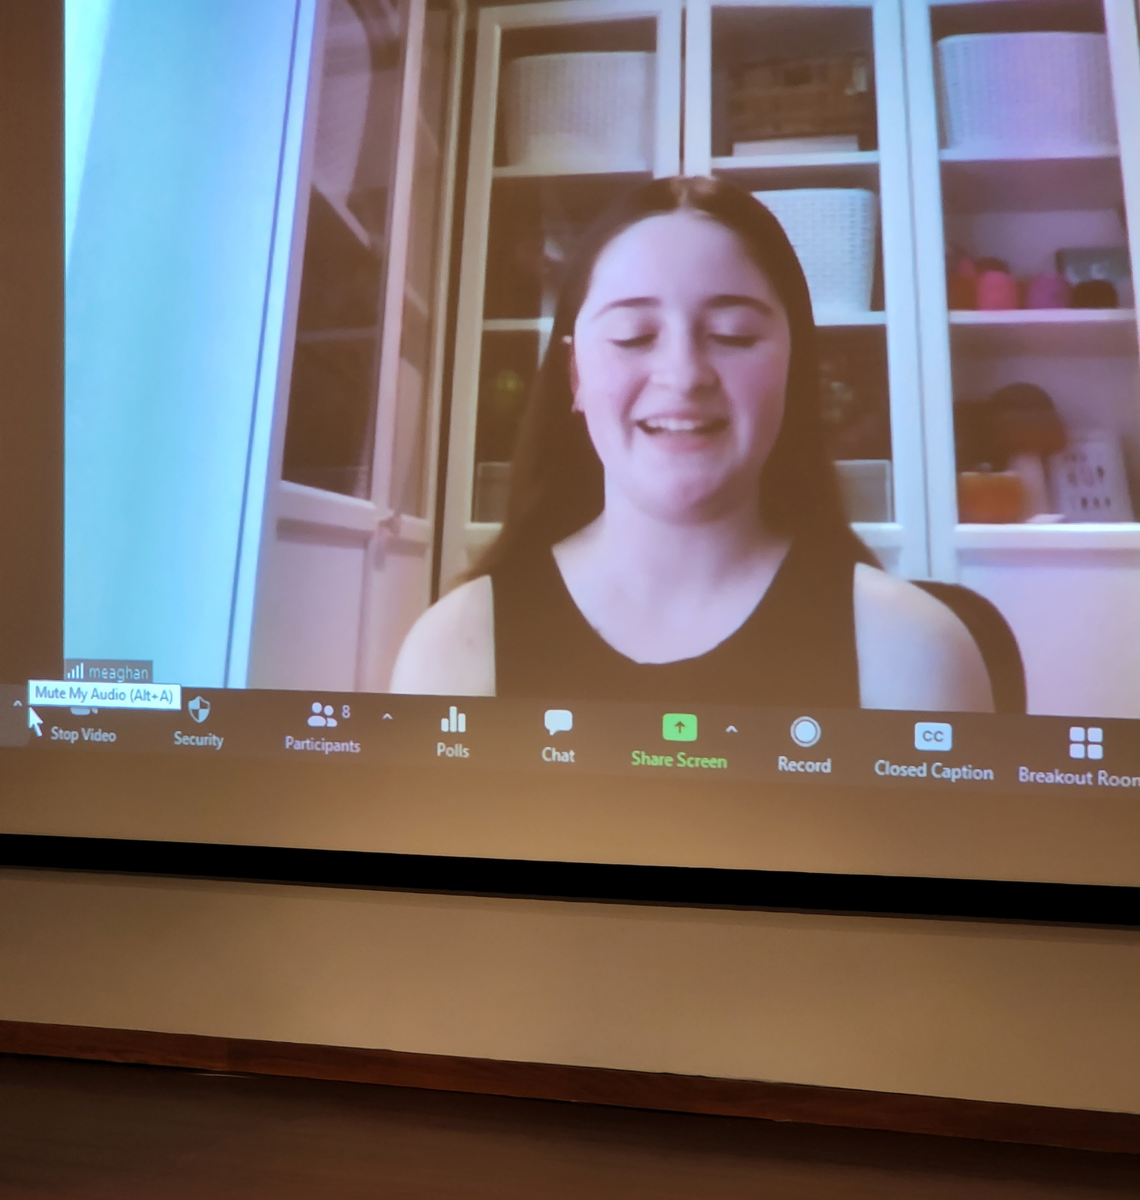


Isabelle Marois, Age 14
Future of Earth
Oil Pastel
1st Place
Kingston, Ontario, Canada

Slide 16
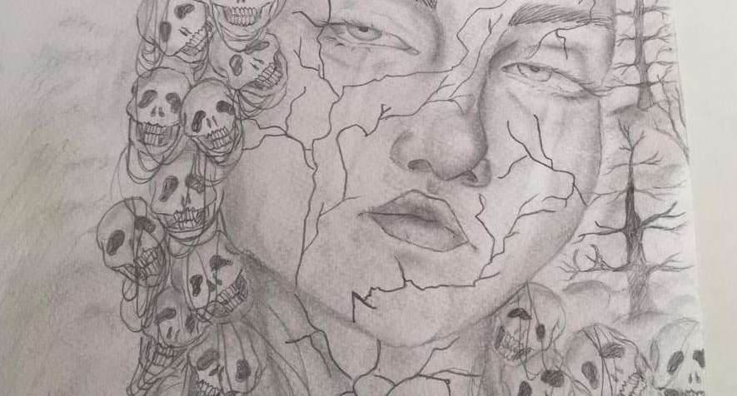

Hiba El Ouargi, Age 17
Water Doom
Pencil
1st Place
Marrakech, Morocco

Slide 17
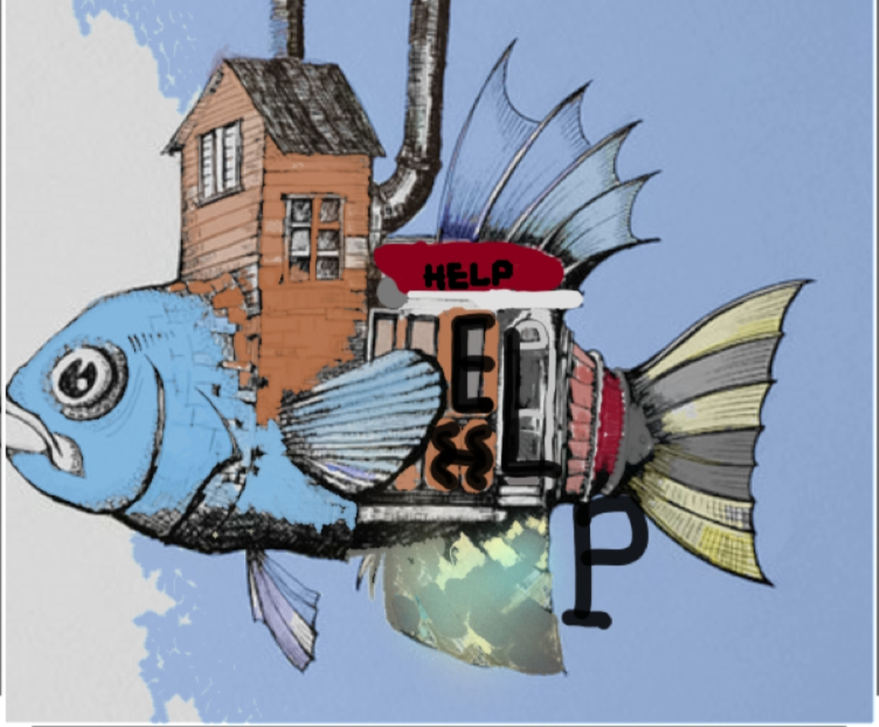

Ouiam Erbiyab
Age 16
“Fish Out of Water”
Pencil
2nd Place
Marrakech, Morocco

Slide 18
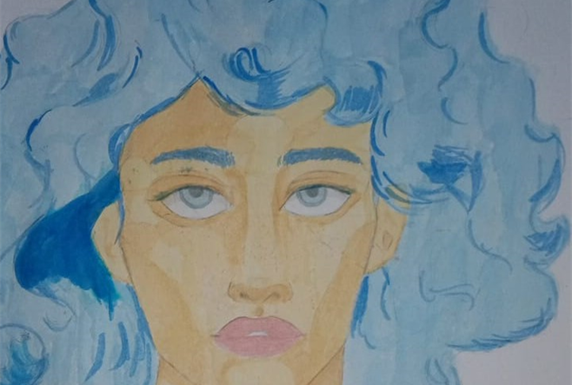
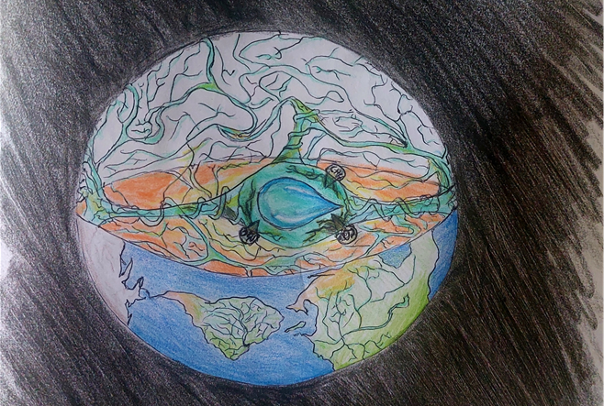

Aya Gallal, Age 18
Save Me, I’ll Save You
Watercolor
3rd Place
Marrakech, Morocco
Yahya Foutouh, Age 16
Heart of Earth
Color Pencil
Honorable Mention
Marrakech, Morocco

Slide 19
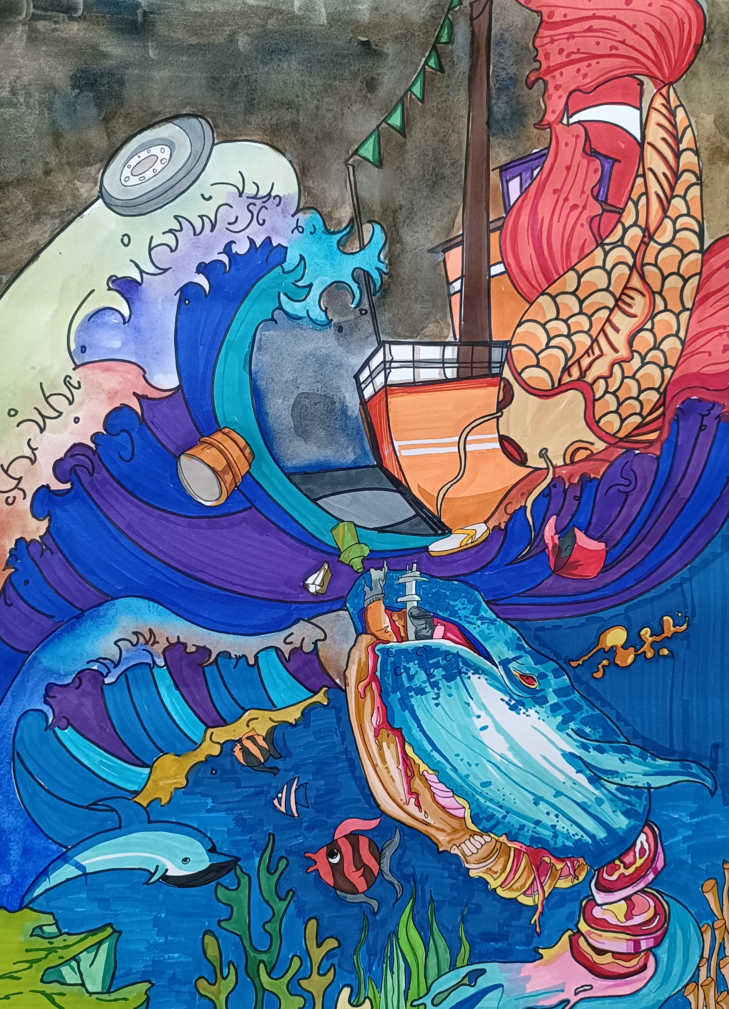
Wang Xuan
Age 15
Marine Life Importance
Marker, Pen
1st Place - Haikou, China
“Nowadays, people’s attention to water resources has begun to increase. This work uses the ugly appearance of the blue whale in the deep sea compared to the life of a dazzling goldfish. The blue whale is embarrassed in this vast blue ocean, trying to break the bondage, looking at the sails, but I don't know that the goldfish also pays the price of freedom. But the blue whale's desire can only sink into the boundless seabed silently. Maybe you have longed for that dazzling life. This warns human beings to pay attention to water resources.”

Slide 20
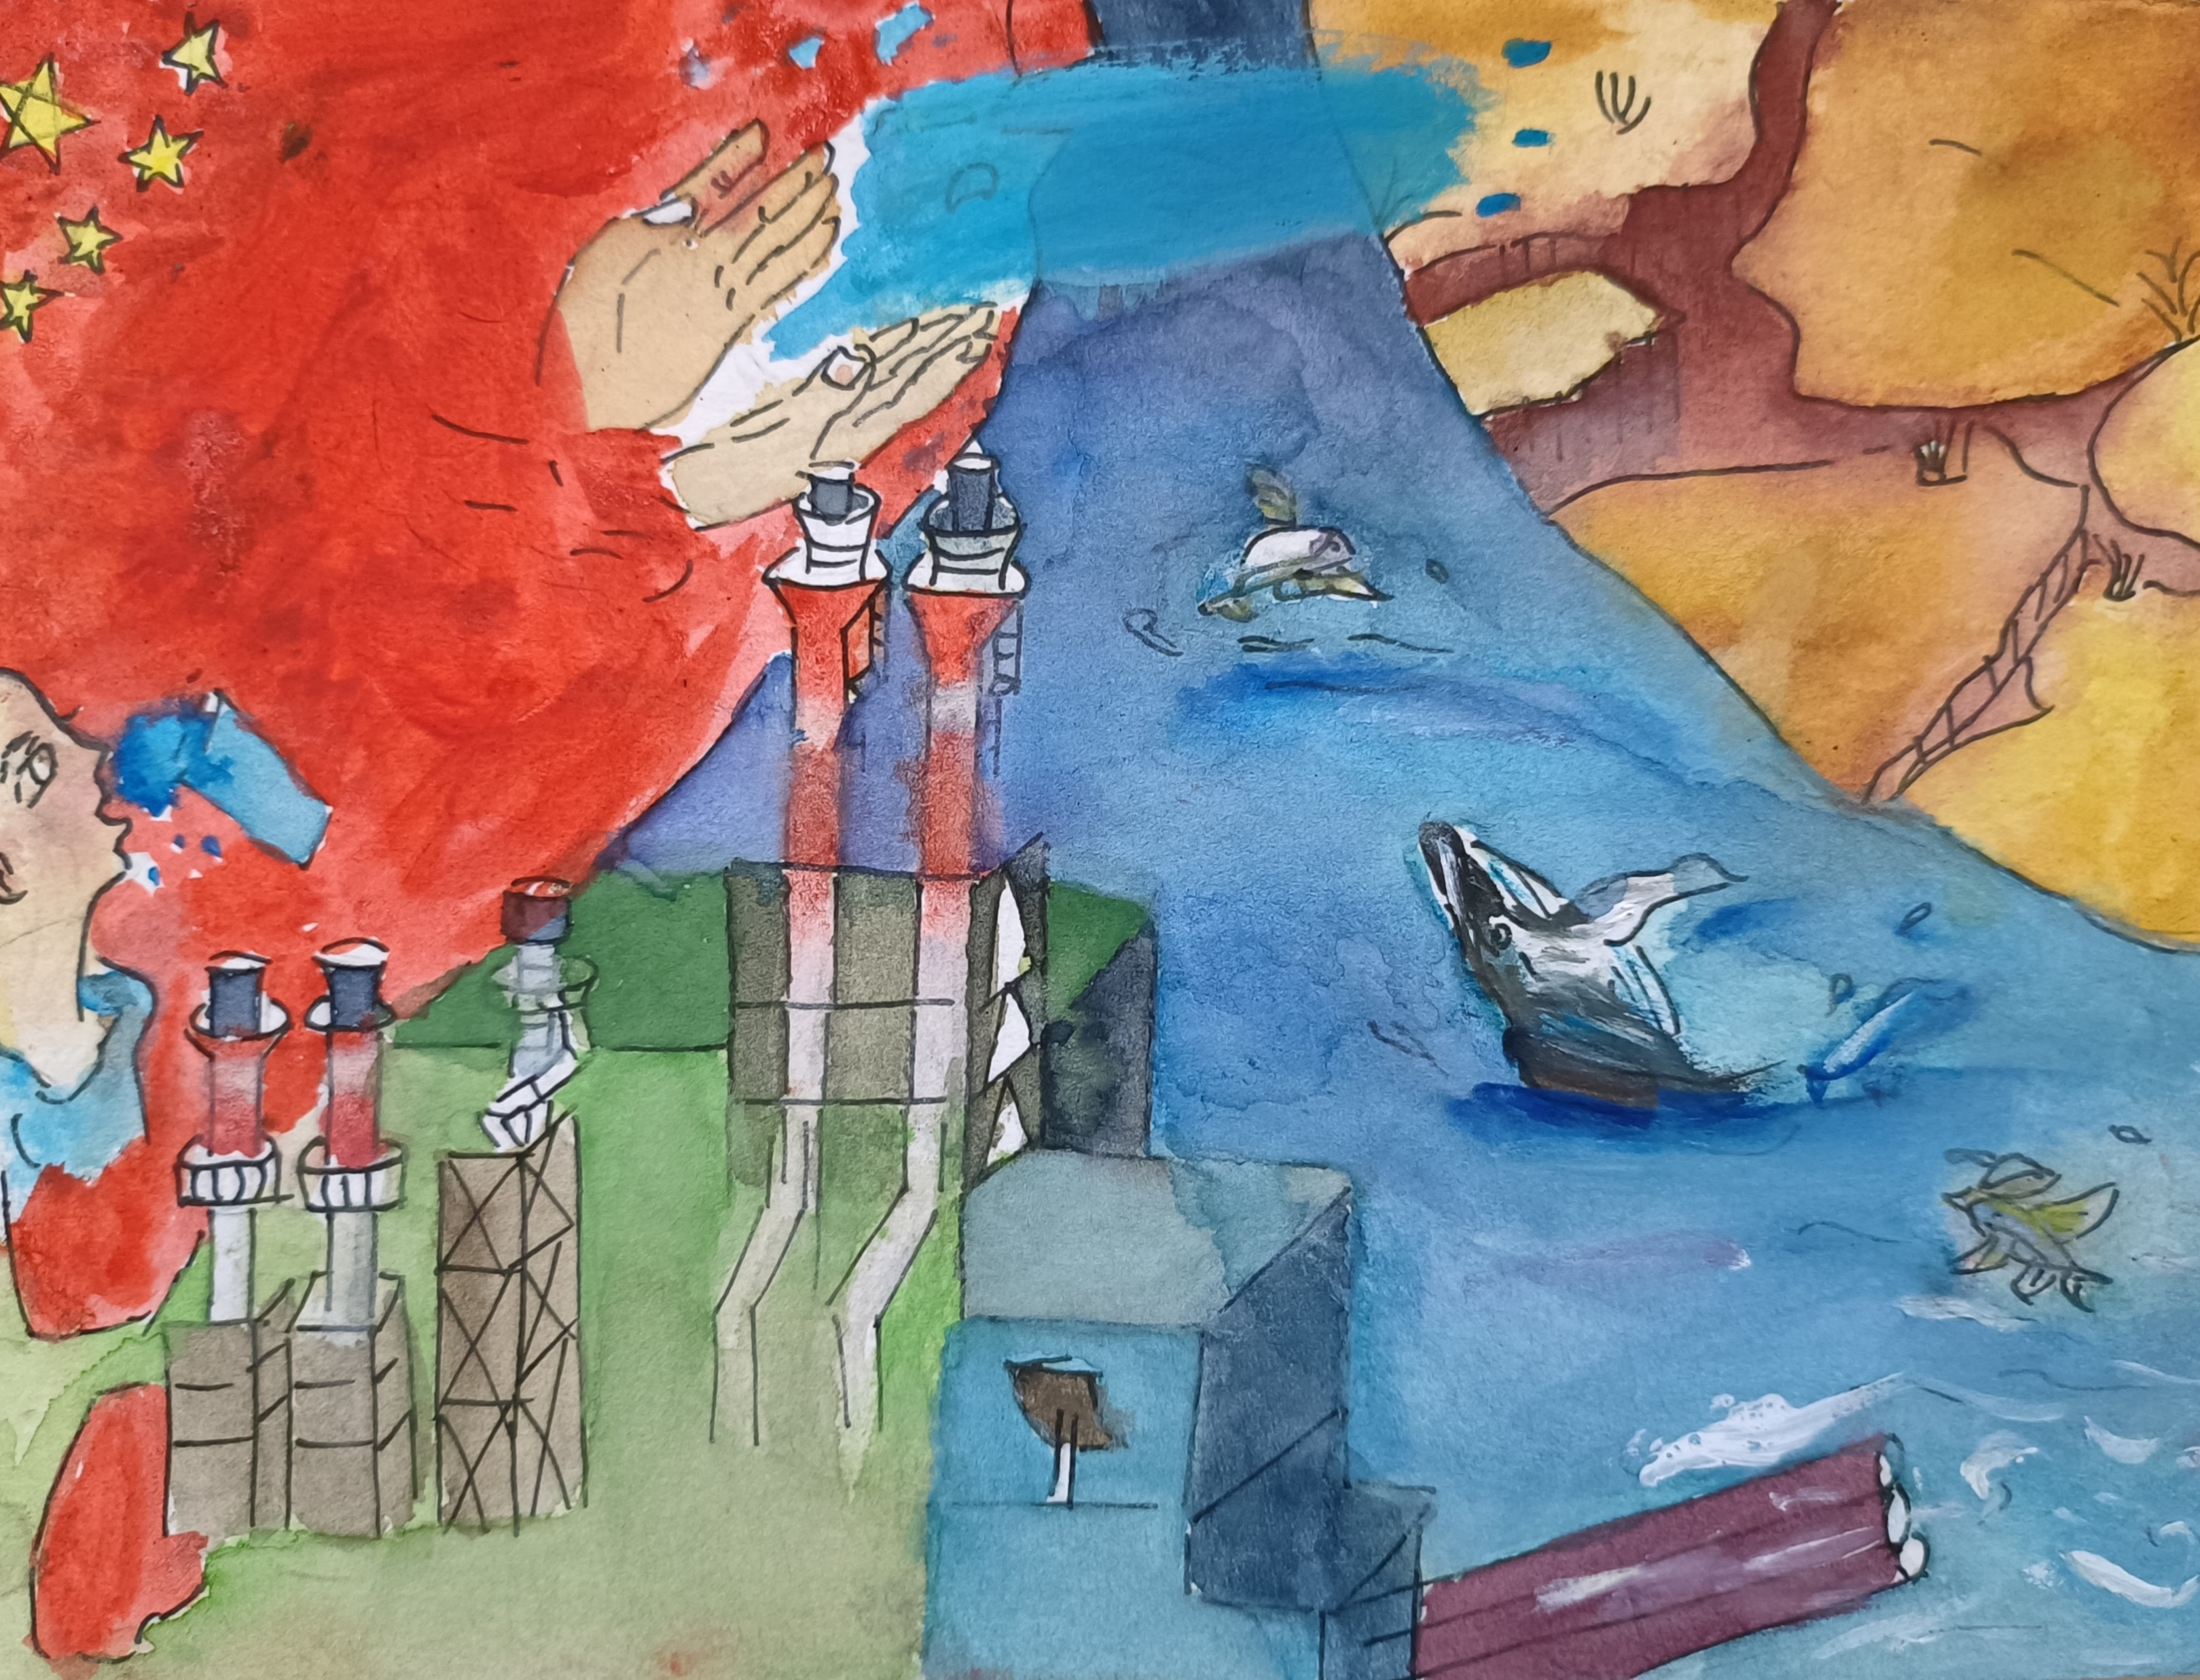
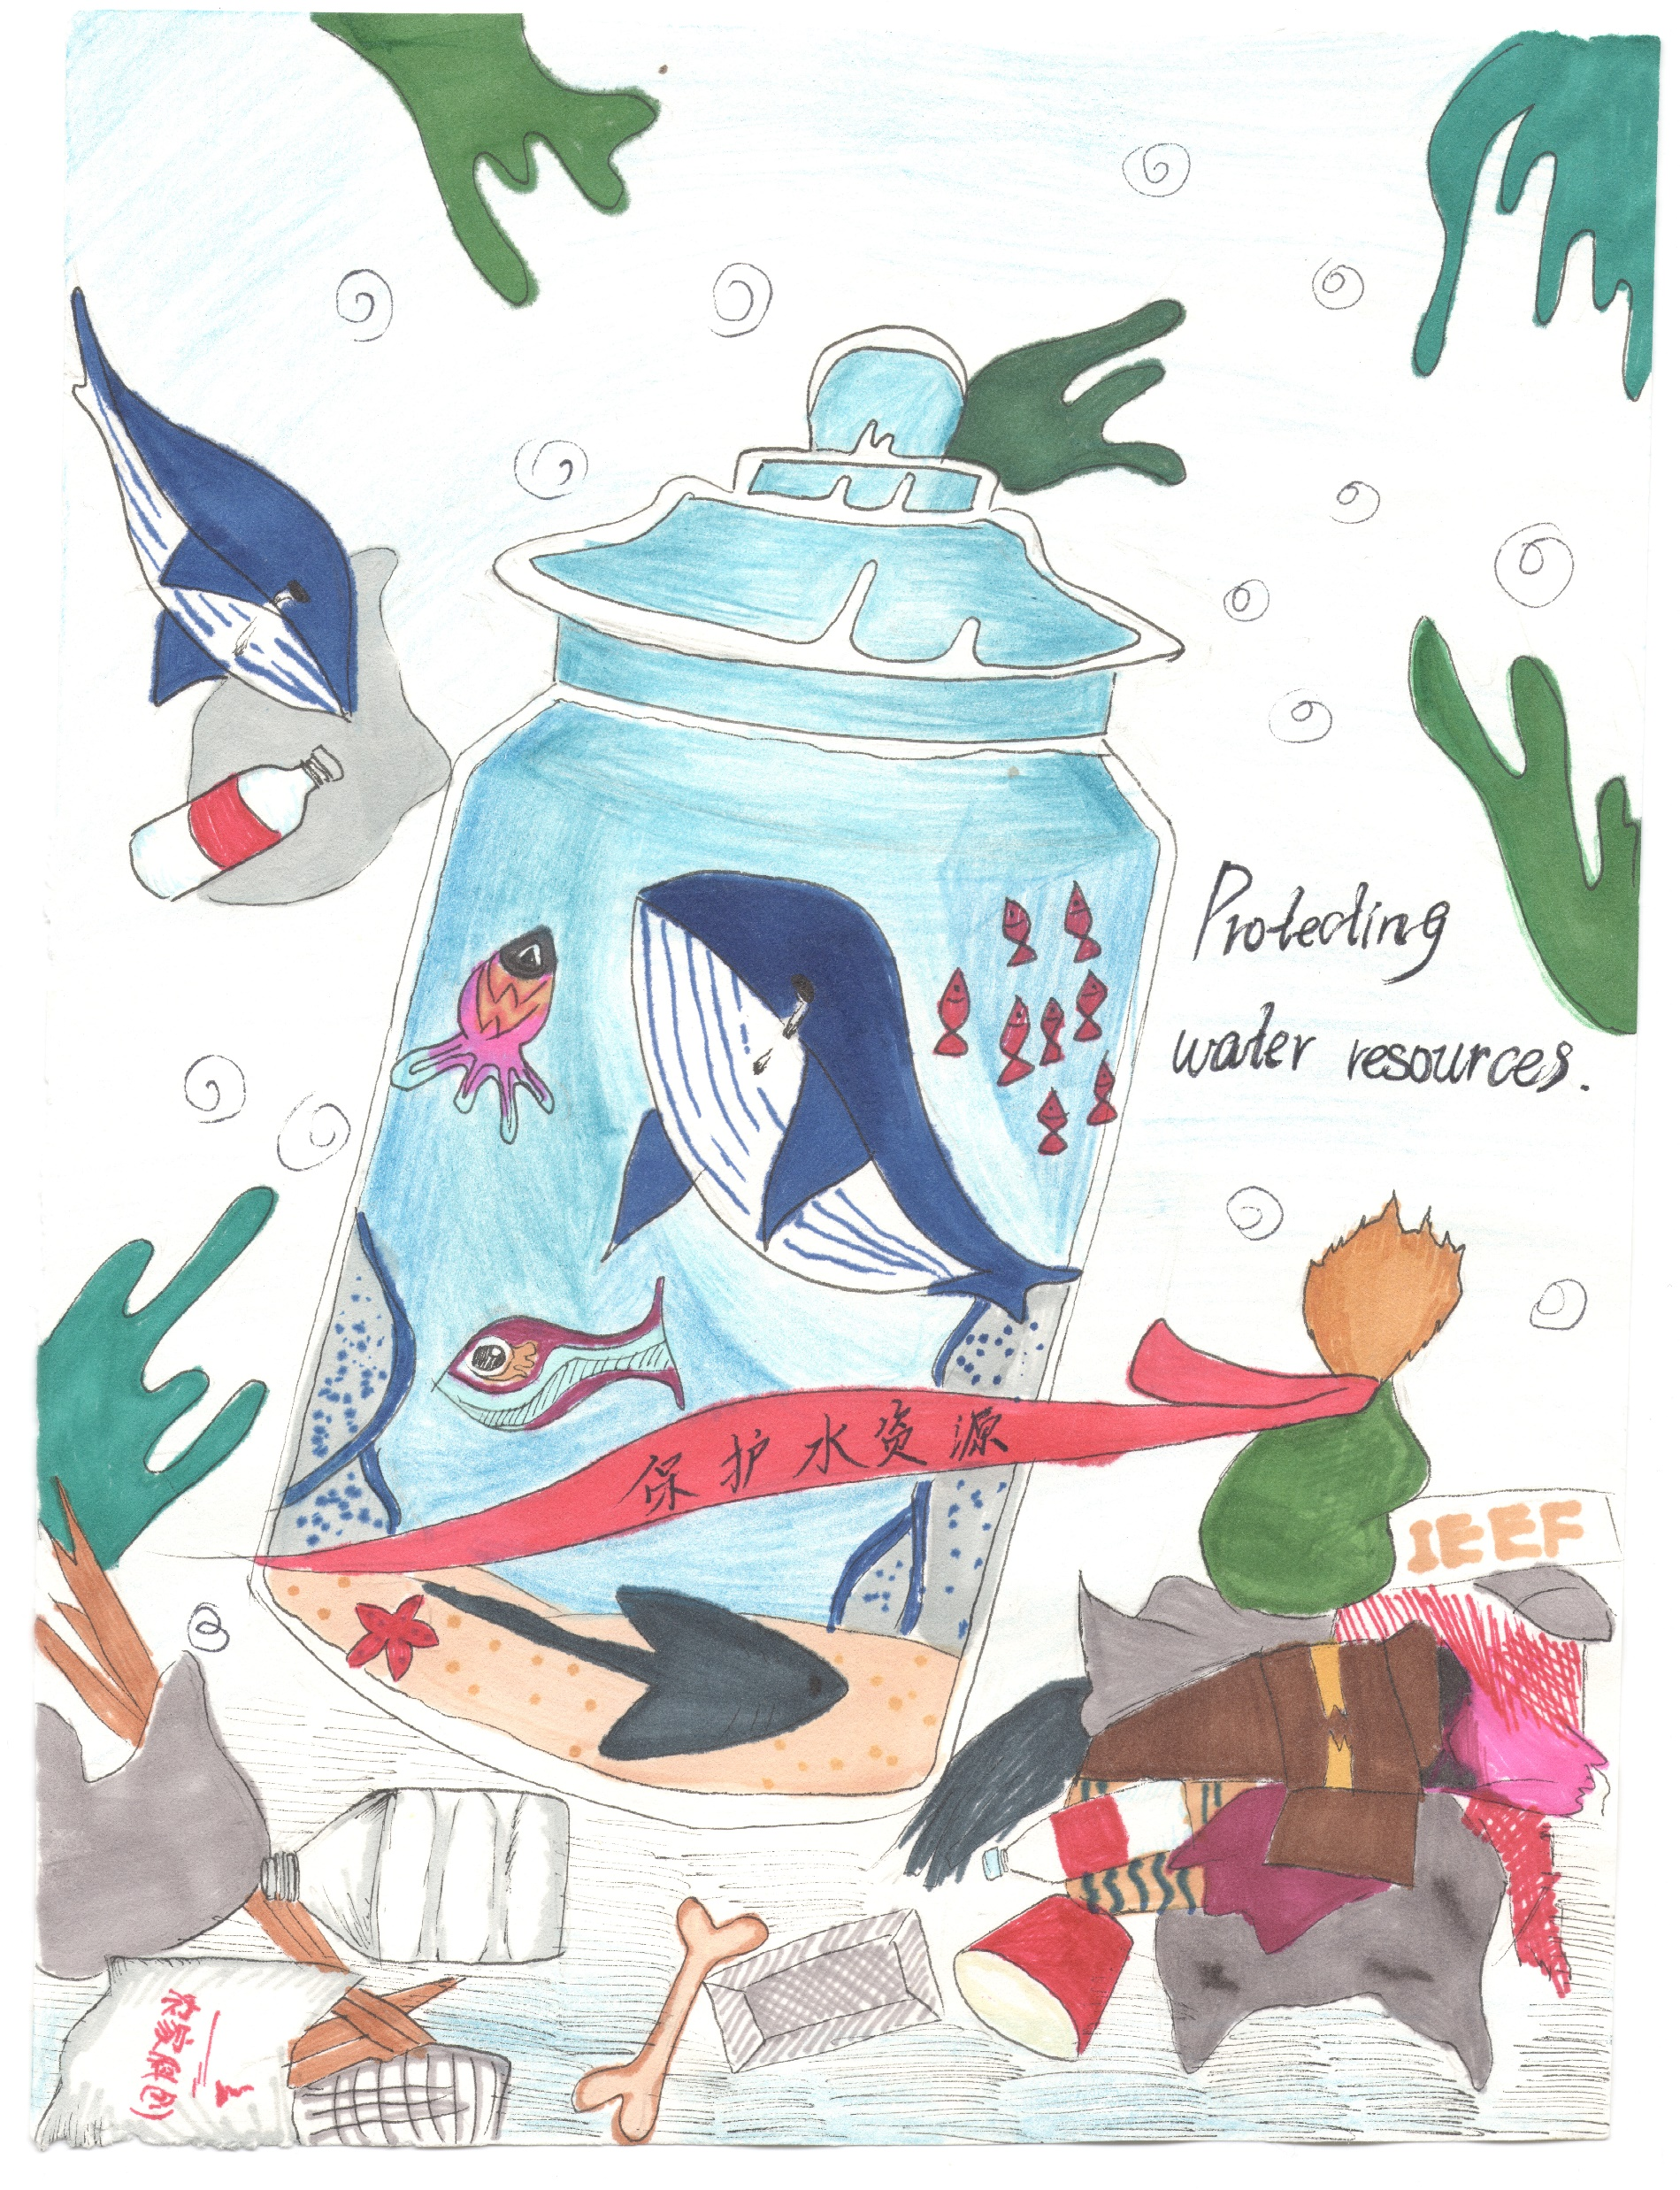

Lin Boyi
Age 13
Mystery of Magic
Watercolor
3rd Place
Haikou, China
Du Yaojing, Age 17
Factory and Whale
Watercolor
2nd Place - Haikou, China

Slide 21
